Slide 1
Gifts and Advancement at the University
Notes:
Kyle

Slide 2
What is the Office of Advancement at CU Denver?
Who we are:
Philanthropic arm of the university
Growing team of 18 comprised of:
Philanthropic Advisors
Corporate and Foundation Relations
Alumni Relations
Marketing and Communication
Stewardship and Events
Planned Giving (e.g. wills and bequests)
What we do:
Secure resources for the campus by bringing people together to solve real problems
Focus is on gifts above $10k (potentially raising to $25k)
Previous three FY totals: ~$54M
Current FY (in progress): ~$10M
Notes:
TK

Slide 3
Advancement Org Chart Anschutz Medical Campus
Scott Arthur
Vice Chancellor
Brie Aguila
Assoc. Vice Chancellor
Mike Pasquarella Assoc. Vice Chancellor
Jim Hodge
Assoc. Vice Chancellor
Karen Aarestad
Assoc. Vice Chancellor
Allison Krebs
Assoc. Vice Chancellor
Communications
Internal Development Team
Strategy
Alumni Relations
Generalist Development Team
Hospital Relations
Administrative Team
School and College Development team
Patient Engagement
Corporate and Foundation Relations
Stewardship
Kyle Jaccaud-Smith
Director of Development
Events
John Bennett
Assistant Dir. Development
Notes:
TK

Slide 4
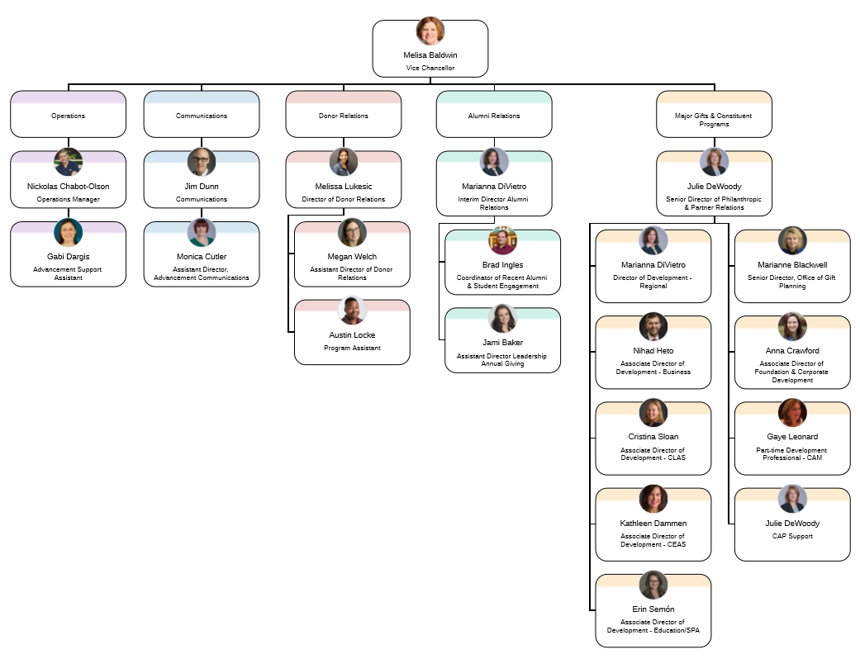
Advancement Org Chart Denver Downtown Campus
Operations
Communications
Donor Relations
Alumni Relations
Major Gifts (10K+)
Embedded fundraisers for each school/college
University-wide foundation and corporate development
Notes:
TK

Slide 5
What is the CU Foundation?
Organization: The CU Foundation is a legally separate 501(c)(3) charitable organization that functions as a part of CU Advancement.
Mission: The CU Foundation receives, manages and prudently invests private support for the benefit of the University of Colorado and support the University’s philanthropic endeavors through donor stewardship.
Services: Gift acceptance, processing and administration. The Foundation invests and allocates gift funds in a manner consistent with the purposes established by donors, and distributes dollars from its managed funds to support a wide variety of programs and activities throughout the University system and on its four campuses.
During financial year 2018, the Foundation processed over 77,000 gifts and commitments.
Notes:
TK

Slide 6
Advancement Gift Process
Donor declines
Development officer (DO) identifies potential donor
DO, faculty, and others develop proposal and solicit
DO works with GAD, internal resources, and donor to develop fund agreement
Donor makes commitment
Fund agreement reviewed and approved by GAD and Legal
New fund setup process initiated with CU Foundation Accounting
University creates speedtype linked to CU Foundation fund
Donor, CU Foundation and University all sign agreement
Donor sends payment to CU Foundation
CU Foundation accepts funds and deposits into newly created Foundation account
CU Foundation issues receipt of payment
Notes:
Kyle
Our process in the simplest form

Slide 7
OGC Pre-award/Contracts Process for Gift Agreements
OGC does not process true gifts, however there are some agreements that blur the line (see Tri-Party Agreements on next slide).
Funding that requires a proposal is likely a grant rather than a gift, and does need to be routed to OGC Pre-award.
Proposals for true gifts should still be routed through OGC.

Slide 8
Tri-Party Agreements
Some sponsors want to issue a grant rather than a gift, but they want to give money to CUF rather than the University.
In this case, we do a Tri-Party agreement. The Tri-Party agreement is treated like a grant, which includes routing the proposal/grant through OGC, and is set up in a Fund 30.
However, the funding flows to the Foundation first and then back to the Fund 30.
The Grant is signed by both CUF and OGC.
Two main sponsors: Caring for Colorado and Colorado Health Foundation.

Slide 9
OGC Gift Post-award Process
Funds that come in for a gift go directly to the CUF.
Departments can set up an account for those funds with a gift request form.
Once the CUF account is set up, CUF sends the foundation account number to the OGC gift accountant.
The OGC gift accountant then sets up a Fund 34 in PeopleSoft, and provides a ST to the department.
OGC.Gifts@ucdenver.edu
SkillSoft Training for Fiscal Manager: CU: Gift Fund Management” ID: scorm12_cu_u00082_0001

Slide 10
“Subcontracting” from a Gift Account
There is no true Subcontract from a gift, because gifts do not have prime contracts.
However, sometimes you may need to flow gift money to another entity to do research.
In this case, we use a “Research Services Agreement”
Treated like a subcontract in process, but document is different.
Requested like a subcontract with a Research Services Request form.

Slide 11
Grants vs. Gifts
Unfortunately, it is not always clear …
Need to look at the intent, what is being funded
Upfront discussions between OGC-Advancement
Notes:
Kyle

Slide 12
Philanthropic
Is it a Grant or is it a gift?
Grants and Contracts
Donated by individuals, trusts, private or corporate foundations
Given with “no strings” attached (only report of the use of funds is expected)
Scholarships or educational aid (donor may not determine who receives funds)
Project based funding (e.g. programmatic support for a science fair or summer bridge program)
Grantor expects something in return for the funding
Funding of specific research protocol
Publication rights are involved
Specific research involves human and animal subjects
Examples:
Clinical trial with industry as sponsor
NIH awards
State of Colorado
Industry research
Notes:
TK

Slide 13
When to involve OGC
The sponsor is a government entity - including public school or local government agency
There is potential for intellectual property ownership and rights issues with funder
Involves human subjects (and/or requires Institutional Review Board)
Involves animals
Deliverables are expected by the funder (and donor expects funds returned if not delivered)
Donor expects full accounting of project expenses
Only 1 proposal submission is allowed by funder
Grantor involves peer review process
The funder has historically funded through OGC
Donation is coming from a foreign country
Notes:
TK
Not everything is black and white so what if you’re not sure?
These are some red flag to look for that would signal we need to be working with OGC

Slide 14
Examples
Community First Foundation
Warm Connections – provide preventive mental health support for mothers on WIC program
Specific research protocol - involves human subjects – conduct needs assessments
Design pre-post intervention measures to assess impact. Obtain approval to collect data in WIC clinics
Administered in OGC
Notes:
Kyle – TK chime in as needed

Slide 15
Examples
Perlman Family Foundation
Initial conversations were broad research objectives
Changed to a specific research protocol which received a scientific review by the Foundation
Foundation outlined terms and after agreement came back – clear it was a contract
OGC brought in to re-negotiate the agreement and administer the funds
Notes:
Kyle – TK chime in as needed

Slide 16
Examples
Facebook
Faculty member saw the open research RFP online and initially reached out to OGC staffers who worked within the CEAS
Based on the lack of reporting requirements and the “unrestricted” nature of the gift, OGC involved Advancement
Advancement discussed with CUF and OGC – determined that CUF was able to accept funding
End result: faculty member worked with Advancement to develop and submit research proposal
Notes:
Kyle – TK chime in as needed

Slide 17
Questions?
CU Anschutz Advancement: Kyle Jaccaud-Smith, Director of Development Corporate and Foundation Relations; Kyle.jaccaudsmith@ucdenver.edu
CU Denver Advancement: Anna Crawford, Associate Director of Foundation and Corporate Development; anna.crawford@ucdenver.edu
Gifts vs Grants: TK Keith, Manager of Compliance and Training for Financial Services; Thomas.Keithiii@ucdenver.edu

