Slide 1
Creating Basic NIH Budgets
Advanced PreAward Course
Annie Vazquez
PreAward Specialist
Department of Biochemistry and Molecular Genetics

Slide 2
Goals for this course:
Learn how to create a basic NIH modular budget ($250,000 Direct Costs per year)
Give you a foundation for budget making that will help you create more challenging NIH budgets in the future
This course is meant to help you navigate NIH and UCD requirements/rules/policies/regulations

Slide 3
Getting started
NIH SF424 Instructions: https://grants.nih.gov/grants/how-to-apply-application-guide/forms-e/general-forms-e.pdf
NIH Parent R01 Program Announcement: https://grants.nih.gov/grants/guide/pa-files/PA-19-091.html
Where to create budgets: directly in InfoEd, using your own excel spreadsheet, or whatever works best for you
Communication with the PI is key

Slide 4
Overview of topics covered in this course
Categorizing Personnel
Salaries and Benefits
Capital Equipment
Supplies
Travel
Other Expenses
Facilities and Administrative Costs (F&A)

Slide 5
Categorizing Personnel
Personnel Types:
Senior/Key Personnel - people in this category are generally the Principal Investigator, Co-Investigators, or anyone else with major scientific contributions to the project.
Non-Key/Research Support Personnel – people in this category are generally Postdoctoral Fellows, Professional Research Assistants, and Graduate Students
Other Significant Contributors – people in this category are not included in the budget. They do not dedicate measurable effort to the project.
Example: Someone providing advice or special expertise in a new technique or scientific area
How do you know which category is appropriate? Talk to the PI!

Slide 6
Salaries and Benefits
Looking up salary information for UCD employees (see handout)
If you are collaborating with someone at the downtown campus, you may want to double check their salary info with someone in their department. HCM does not account for tenure increases and those can be substantial.
Converting percent effort to person months
Example: PI with 12-month appointment will dedicate 25% effort
12.00 months x 0.25 = 3.00 Calendar months
Example: PI with 9-month appointment will dedicate 25% effort
9.00 months x 0.25 = 2.25 Academic months
You can also easily search the internet to find several calculator excel spreadsheets
Fringe Benefit rates for UCD: http://www.ucdenver.edu/research/Research%20Administration%20Documents/Fringe%20Benefits%20Rates%20for%20Grant%20Proposals,%20UCD.pdf
Can include 3% salary increases each year

Slide 7
Capital Equipment
Items of equipment costing over $5,000
These items will be exempt from F&A calculations
If a piece of equipment requires multiple components, you should add up all component costs to determine if the item should be categorized as ”capital equipment”
Equipment costing less than $5,000 can go into the “supplies” or “other expenses” categories

Slide 8
Materials/Lab Supplies
Lab supplies is a very general category and the items included will vary based on the project
Examples: reagents, chemicals, media, buffers, small equipment items, consumable supplies such as plasticware, glassware, pipette tips, etc.

Slide 9
Travel
Travel fits into two categories: domestic and foreign travel
Travel costs vary considerably based on the project.
Common reasons to include travel costs
Research Conferences/Scientific Meetings
If PIs or other project personnel (postdocs, grad students) intend to serve as guest speakers, present posters or other research data, etc.
Travel to a collaborators laboratory
If PIs or other project personnel need to go to a collaborator’s lab to learn a new technique, discuss data/other project details, etc.

Slide 10
Other Expenses
Common types of expenses for this category
Animal Costs (costs for purchasing animals, housing/food/care costs, animal husbandry, etc.)
Core Facility User Fees (provide a specific service or use of special equipment to PIs for a fee)
Publication Costs (poster printing cost, scientific publication fees)

Slide 11
Other Expenses (cont’d)
Common types of expenses for this category
Tuition Remission (if you are including graduate students on your budget, you should also be requesting Tuition Remission costs)
How much should you request?
Will depend on the student’s program. You can look up information for tuition remission costs on the graduate school’s website: http://www.ucdenver.edu/academics/colleges/Graduate -School/prospective/Pages/cost.aspx
Tuition Remission costs will be excluded from F&A

Slide 12
Other Expenses (cont’d)
Calculating Tuition Remission
For my department, I assume 15 credit hours per semester for our students. This assumes the student is attending full-time.
Tuition per credit hour x 15 credits = Tuition cost per year
Tuition costs per year $7.008.75 (will vary based on the student’s program)
Health insurance $4,395.24
Dental insurance $288.75
Other fees $390.65 (will vary based on the student’s program)
Total $12,083.39

Slide 13
Other Expenses (cont’d)
If the graduate student on the budget will be dedicating 100% effort/12.00 calendar months, you should request the full amount for tuition remission costs for this type of grant
You will need to prorate the amount if the student will have less effort
Calculation example: Student at 75% effort/9.00 calendar months
Tuition remission costs x percent effort
$12.083 x 0.75 = $9,062
Finally, the other expenses category can be used for anything else that doesn’t fit into one of the other categories

Slide 14
Facilities and Administrative Costs (F&A)- also known as Indirect Costs
Calculating F&A costs
OGC’s F&A matrix: http://www.ucdenver.edu/research/Research%20Administration%20Documents/FAGrid_2017_2018.pdf
UCD’s F&A Rate Agreement: http://www.ucdenver.edu/research/OGC/awardadmin/preaward/Documents/Negotiated%20Rate%20Agreement%20dated%20March%208%2c%202016.pdf
For our example budget, the items that are exempt from F&A costs will be Capital Equipment and Tuition Remission

Slide 15
Final Calculations
Finding the F&A Base Total (the amount of the budget that will be charged F&A costs)
Annual Direct Costs – exempt/excluded budget items = F&A Base Total
$250,000 - $24,062 = $225,938
Figuring out F&A Costs
F&A Base Total x appropriate F&A rate = F&A Costs
$225,938 x 0.555 = $125,396

Slide 16
Final Calculations (cont’d)
Finding the Grand Totals (also known as Total Costs)
Direct Costs + F&A Costs = Grand Total/Total Costs for Y1 of the budget
$250,000 + $125,396 = $375,396
Adding it all up
Total Costs for all years
Y1: $375,396
Y2: $379,281
Y3: $383,721
Y4: $383,721
Y5: $383,721
Total costs for entire project period: $1,905,838

Slide 17
Tips, Tricks, Common Mistakes, and Proposal Nuances
Advanced PreAward Course
Grant Garceau, Business Analyst, Office of Grants and Contracts
Annie Vazquez, PreAward Specialist, Dept. of Biochemistry and Molecular Genetics

Slide 18
Topics
Sponsor Instructions
University vs. Sponsor Requirements
Common Budget Mistakes
InfoEd
NIH Topics
VA MOUs
Intergovernmental Personnel Agreements (IPAs)

Slide 19
Sponsor Instructions
Some sponsors have multiple sets of instructions that must all be read in conjunction – provide all instructions with the routing
DOD: Program Announcement AND General Instructions for CDMRP programs
Other sponsors have information on their websites not in the RFP
Examples include indirect cost rate limits, salary caps (PCORI)
Some application forms have additional information not listed elsewhere or additional clarification
Additional information on indirect costs
Sponsors can update their funding opportunities and policies
Related notices and FAQs for NIH – fellowship / training stipend rates
DOD Program Announcement amendments – changes in due dates

Slide 20
Sponsor Instructions (cont’d)
Common Mistakes
Using the NIH salary cap for other sponsors without one – e.g., DOD, NSF
Not reading the entire funding announcement or all the instructions
NIH K99/R00 applications – R00 instructions are at the very end of the FOA. K99 submission is a system to system application while R00 is an email submission on PHS 398 forms
https://grants.nih.gov/grants/guide/pa-files/PA-18-398.html

Slide 21
University vs. Sponsor Requirements
CU has its own separate requirements on top of sponsor requirements for proposals
http://www.ucdenver.edu/research/OGC/awardadmin/preaward/Pages/routing.aspx
Requests for extramural funding must always be routed, even if the sponsor instructions say approval or signature by the organization’s grants office is not required
Certain documents must always be routed, even if not requested by the sponsor:
Detailed internal budget
Budget justification or Scope of Work
Signed consortium letters for proposed subcontracts
Consortium subcommitment forms / letters of intent: Must also be signed by the UCD PI if they contain dollar figures, but only one form needs the PI signature if multiple forms required by the sponsor

Slide 22
University vs. Sponsor Requirements (cont’d)
Inclusion of sponsor application / online forms
Include PDFs of any online application forms
In your browser, select print, chose either Adobe PDF or Save as PDF, and save the online forms. Include these with the routing
Any applications done in proposalCENTRAL fall into this category
OGC does not always have access to sponsor instructions in these portals so they need to be included with the routing
Institutional Signatures
OGC will always be the last signatory at UCD on any form. OGC will not sign the application documents until all other signatures from UCD personnel are obtained
OGC is the last UCD signature, but IPAs will be signed by the government agency after
Missing signatures is one of the most commons reasons proposal reviews are delayed

Slide 23
University vs. Sponsor Requirements (cont’d)
Salary Verification
Any proposed base increase of more than 5% in year 1 for the PI without salary verification will result in PreAward requesting documented approval from the department of the change
Example: $100,000 at 1.0 FTE to $125,000 at 1.0 FTE
Approval must come from an appropriate source:
Chair / Dean
Director of Finance / Department Administrator / HR Director
PI Supervisor / Appointing authority
Approval should ideally include
PI Name and job title
Date, year, or timeframe of salary increase or promotion
FTE of proposed position
New base salary
Notes:
Salary verification is also needed for non-standard raises after the first year. Include verification for tenure, promotions, or other increases that would result in a non-standard increase in any year.
Verification is usually in the form of an email or a letter of offer. The letter of offer does not need to be fully executed

Slide 24
Common Budget Mistakes
Equipment
Classifying items incorrectly as equipment or using the wrong budget category in InfoEd
Fringe Rates
Using the wrong fringe rates for personnel
Patient Care Costs
Only certain costs qualify as patient care
Indirect Costs
Using the wrong calculation for indirect costs
Notes:
Some sponsors also prohibit salary escalation such as the National Multiple Sclerosis Society

Slide 25
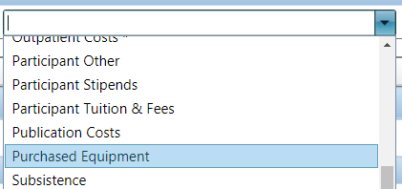
Common Budget Mistakes (cont’d)
Equipment
Equipment is defined in our F&A rate agreement:
Tangible nonexpendable personal property having a useful life of more than one year and an acquisition cost of $5,000 or more per unit
Yes: One computer server for $10,000 and one -40°C freezer for $5,000
No: Three laptops at $3,000 each for $9,000 total
Equipment in InfoEd uses the Purchased Equipment category
Equipment or Facility Rental/User Rental Fees is a different category

Slide 26
Common Budget Mistakes (cont’d)
Incorrect fringe rates for personnel
Job Code, Department code, and FTE determine appropriate fringe rates
1306 Research Associate – Faculty not PRA fringe
1105 Instructor – Faculty not Staff fringe
Denver vs Anschutz – Department Code determines correct fringe
Denver Campus: Department Code field on Work Location tab starting in 3 in HCM
Anschutz Campus: Department Code field on Work Location tab starting in 2 in HCM
Full vs Part time
Some job classifications have different fringe rates for full vs part time appointments (faculty), while others (PRAs) have the same fringe regardless of FTE

Slide 27
Common Budget Mistakes (cont’d)
Patient Care Costs
A very limited number of costs count a patient care costs
Occur at Off-campus locations such as university hospital and fall into one of the following account codes
Hospitalization Cost 520100
Inpatient Charges 520101
Outpatient Charges 520102
Ancillary Charges 520103
External Patient Service 520104
Participant payments / incentives / compensation are not patient care costs and should not be exempted from the indirect cost base

Slide 28
Common Budget Mistakes (cont’d)
Indirect Costs are calculated one of two ways by most sponsors:
Indirect costs as a percentage of direct costs
Used by most sponsors and how InfoEd calculates indirect costs
Indirect costs as a percentage of the total award
Results in a percent of direct costs rate higher than the percent of total award rate
Please note, this is not indirect costs on top of indirect costs and most budget templates need to be modified to calculate this correctly

Slide 29
Common Budget Mistakes (cont’d)
Indirect costs as a percentage of direct costs
Total Cost Limit / 1 + Indirect Cost Rate
$200,000 Award Amount
10% Indirect Cost Limit
200,000 / 1.1 = $181,818 TDC + $18,182 Indirect costs

Slide 30
Common Budget Mistakes (cont’d)
Indirect costs as a percentage of the total award
Total Cost Limit X Indirect Cost Rate / (Total Cost Limit – (Total Cost Limit X Indirect Cost Rate))
$200,000 Award Amount
10% of total award amount indirect costs
200,000 X 0.1 / (200,000 - (200,000 X 0.1)) = $180,000 TDC + $20,000 Indirect costs
Conversion to get indirect costs as a percentage of direct costs
Total award amount X Indirect cost rate / (Total Award Amount - Total Award Amount X Indirect cost rate)
200,000 x 0.1 / (200,000 – 200,000 X 0.1) = 11.1111111%
This is how the award will get set up in PeopleSoft if awarded
Notes:
CRA exam question. You will need to know how to calculate this for the exam

Slide 31
InfoEd Tips
Proposal Status
OGC tracks proposal status for all reviews, JIT requests, and prior approvals
Go to PT → Edit → Status History
The top status will indicate where in the process the review is, who is working on it, and when it was last updated. If you have any status update questions, send them to the current reviewer
eRA Support does not deal with the reviews. Start with the PreAward reviewer listed or xenia@ucdenver.edu as a backup for any status requests
Any questions on reviewed proposals should be directed to the PreAward Specialist listed on the return cover sheet
After an award is made, status updates are recorded in the Activity Log
Go to PT → Edit → Activity Log
The Award Setup team and OGC PostAward use the activity log and questions should be directed to the correct team depending on where in the process the award is

Slide 32
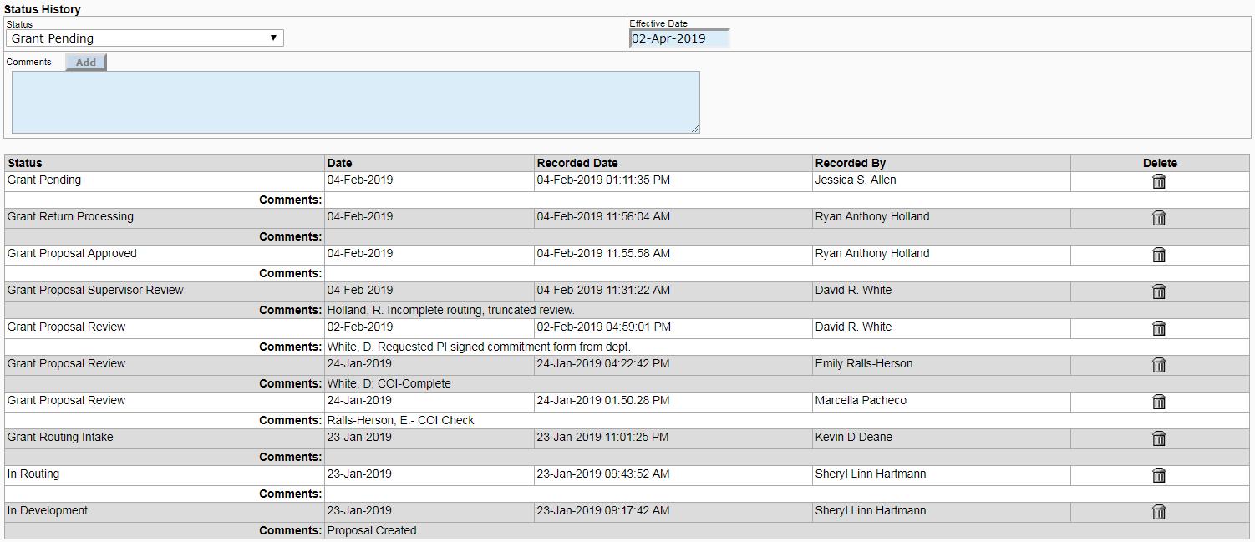
InfoEd Tips (cont’d)
Proposals Status

Slide 33
InfoEd Tips (cont’d)
Conflict of Interest
Conflict of Interest disclosure is required for all named personnel for various sponsors such as NIH, NSF, AHA, etc.
Current list of PHS agencies can be found at: http://thefdp.org/default/fcoi-clearinghouse/fcoi-agencies/
Some Non-PHS entities also require COI disclosures as well. Contact Emily Ralls-Herson in PreAward for questions or if you need the list
Make sure the correct profile is added to InfoEd in the routing and avoid making temporary profiles for people not in the system. COI will not show as complete for the proposal otherwise
Typically, the profile with the middle name or initial included is the correct profile

Slide 34
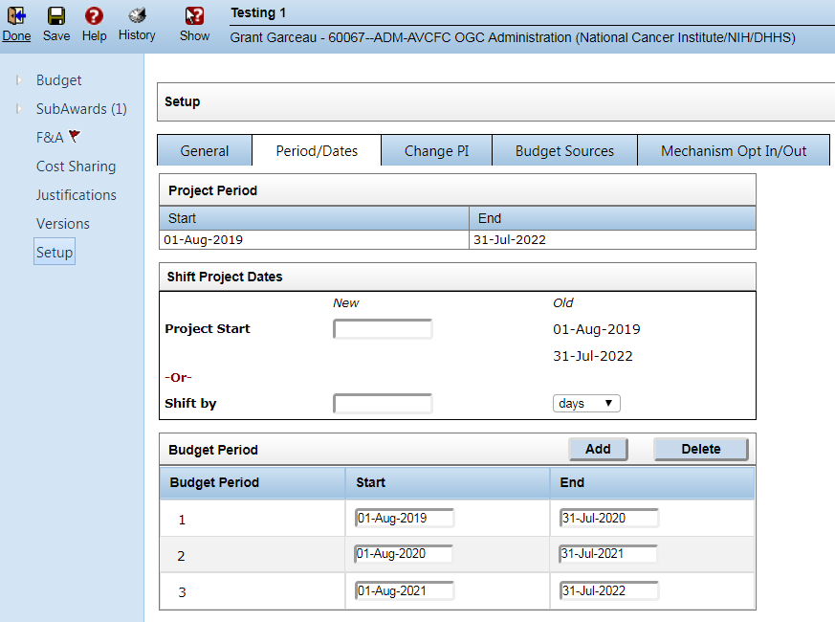
InfoEd Tips (cont’d)
Budget Periods
The budget period for a routing can be altered after creation, either by changing the dates, adding periods, or removing periods
Budget Tab → Setup → Period/Dates

Slide 35
InfoEd Tips (cont’d)
One of the most common issues reported is being unable to complete sections in InfoEd
Unsupported Characters
The current version of InfoEd does not support Greek characters, foreign language characters, or other Unicode symbols (such as a the degree symbol)
Clicking complete on a page with unsupported characters will not give you an error message, but you will be unable to complete the tab. To check for this issue, go to the Finalize tab and run the XML validations. The validations show the sections with the unsupported characters

Slide 36
NIH Application Errors
Other Significant Contributors / Unpaid Personnel
Other Significant Contributors (OSCs): Individuals who have committed to contribute to the scientific development or execution of the project, but are not committing any specified measurable effort (i.e., person months) to the project. These individuals are typically presented at "effort of zero person months" or "as needed." Individuals with measurable effort may not be listed as Other Significant Contributors (OSCs). Consultants should be included if they meet this definition.
https://grants.nih.gov/grants/glossary.htm
OSCs will show up in the Senior/Key personnel section and that allows you to include their Biosketch which will be included with the final application

Slide 37
VA MOUs
Anyone with a dual appointment with the VA must include their current fully executed VA MOU with the routing
NIH requires that any MOUs be updated not less than annually: https://grants.nih.gov/grants/policy/nihgps/html5/section_17/17.3_va-university_affiliations.htm
Base salary for employees with a VA MOU is only their salary at UCD
Budget justifications must include the individual’s UCD effort and the portion of their total professional responsibilities:
[UCD Employee] has a joint UCD/VA appointment. He/She will perform ____ calendar months effort of his/her UCD appointment which is ____ calendar months effort of his/her total professional responsibilities.

Slide 38
Intergovernmental Personnel Agreements (IPAs)
IPAs need to be routed as proposals and not an agreement ready for negotiation – doing otherwise will delay your review
Non-monetary modifications do not need to be routed (early terminations / date changes)
Modifications for additional money should only include the new money
All new IPAs must include the signed standards of conduct form: Standards of Conduct Form
Rules can be found in the VA IPA Handbook (for VA IPAs): https://www.research.va.gov/programs/nppo/docs/va_handbook_5005.doc
Maximum 2 years initial appointment
Maximum 4 years continuous appointment without 60 day break before the 4 years is up or a 1 year break is required
Must be a full-time employee for 90 days before the start of the IPA assignment

Slide 39
Intergovernmental Personnel Agreements (IPAs) (cont’d)
IPAs are the only time budgets should use actual employee fringe benefit rates
Pull employee’s current fringe rate from CU-Data and add the additional amount from the yearly Projected Fiscal Year Fringe Benefit Rate memo from the Budget office
A Printout of this rate should be included with all IPA routings
Current rate is 2.436% but will be updated shortly
IPA fringe rates should also be 3 decimal place accurate

Slide 40
Basic Tips for Application Preparation -Department Perspective
You have to read! And you have to read it all!
Good communication with the PI is the best way to set yourself up for success
Remember that each PI is different
Everyone needs a different level of help
Figure out what mode of communication works for each person
All electronic correspondence? Meeting in person? Discussing over the phone?

Slide 41
Basic Tips (cont’d)
Create your own helpful documents/cheat sheets
Checklists, templates for budgets, budget justifications, examples of other common documents
Spreadsheets that list Radiation or Biosafety Authorization numbers, IRB protocol numbers, or any other numbers you commonly use. If there is some kind of approval certificate, try to get the PI to send you a copy.
Gather as much info as you can from the beginning (questionnaires, request forms, etc.)
This helps both you and your PI!
As PIs get used to using these templates and checklists, they know what to expect and may be more prepared for future applications
You will get better at asking the right questions and providing the most helpful resources with time
If you’re stuck about where to begin, think about what questions you keep asking for each proposal
When you’re still stuck, it never hurts to do a quick search on the internet—there are many templates available and you just need to find the right one for your needs.

Slide 42
Q&A and Comments
Questions about any topics covered today?
Questions about topics we didn’t cover?
Any specific topics you would like to see covered in the future?

Slide 43
Introduction to Logic Models and Theories of Change

Slide 44
Why Do We Care?
Performance Measures and 2 CFR 200
President Management Agenda – Results-Oriented Accountability for Grants
GPRA and GPRAMA
Agency Requirements
Previous focus on federal non-research awards (ED, DOJ, HUD)
Moving into federal research awards
Proposal Requirement for Non-Federal Sponsors

Slide 45
NIH FOA Example
Applications to this FOA are not required to present pilot data in support of the proposed approaches, hypotheses and aims; rather, a well-defined theory of change (or logic model) and associated hypotheses are expected. Applicants are encouraged to provide strong evidence of their capability to conduct the proposed study, through documenting the availability of needed resources, evidence of institutional support, the training and experience of the investigator team, and/or the conduct of related studies.

Slide 46
What are Logic Models?
Visual representation of anticipated results
Identifies and Connects:
Goals, Objectives, and Aims
Inputs
Activities
Outputs
Outcomes
External and Contextual Factors
Improve program design and evaluation

Slide 47
Outputs and Outcomes
Outputs – volume accomplished, produced, or put into action
Number of client referrals
Number of individuals receiving the flu vaccine
Cholesterol level after treatment
Outcomes – results of a project or percent change in behavior, skills, knowledge, attitude, or life condition
Decreased veteran suicide rate
Reduced flu-related absenteeism
Increased understanding of the link between exercise and cholesterol

Slide 48
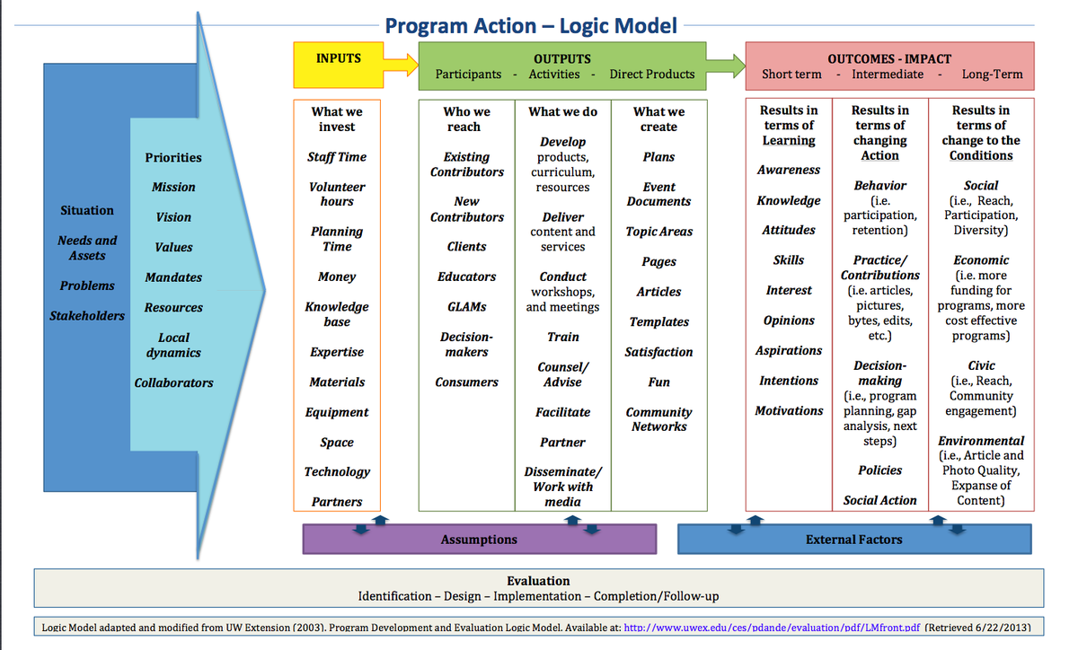

Slide 49
What is a Theory of Change?
Casual Relationship Model
Outcomes-based planning and design
Links outcomes and activities
Explains how and why change is expected
Explanation at each step to identify hypothesis about wh something will cause something else

Slide 50
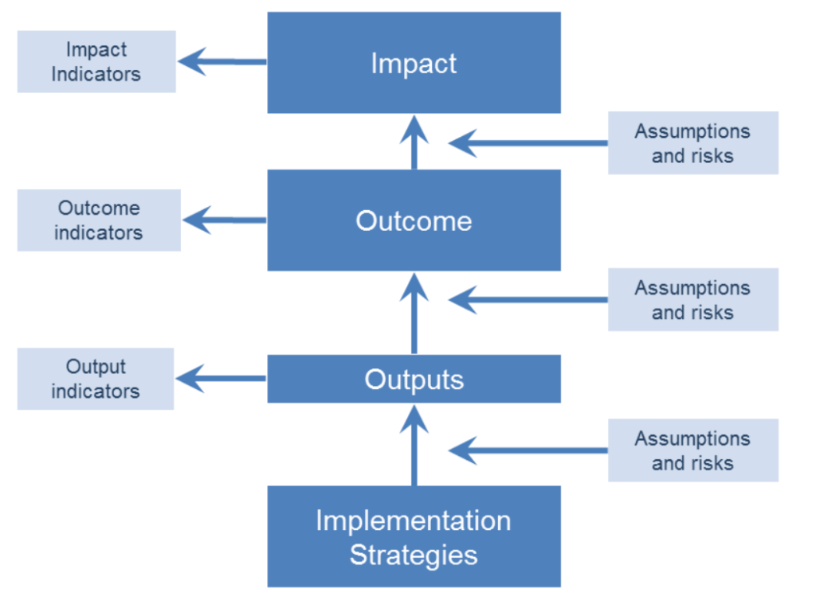

Slide 51
Considerations in Pre-Award
Living document in the proposal development stage
Understand sponsor requirements
Is it a logic model or theory of change?
Do they provide a template?
Plan for a time-consuming learning curve
Recognize the growing importance in proposal evaluation

Slide 52
Connection to Post Award
Road Map for Post Award Activities
Recipient and Sponsor evaluation of project
Measure Cost-Effectiveness Through Unit Cost Data

Slide 53
Resources
University of Wisconsin-Madison
Corporation for National and Community Service (CNCS)
Office of Justice Programs (OJP)
University of Kansas – Center for Community Health and Development
W.K. Kellogg Foundation
USDA – NIFA
CDC

Slide 54
Subcontract Budgeting
Grant Garceau
Business Analyst
Office of Grants and Contracts

Slide 55
Overview
Understanding the PreAward subcontracting process
Federal and foundation subcontract budgeting
Special cases

Slide 56
Subcontracting Process
Once you and the PI have determined that outside expertise or work is required, a determination on if you will be issuing a subcontract or using a purchased service must be made
OGC provides a determination checklist on its website to help PIs and Research Administrators make that determination: http://www.ucdenver.edu/research/Research%20Administration%20Documents/SubrecipientDeterminationChecklist_2016Sept.doc
Do this as early on as possible, as adding subcontractors will substantially increase the time needed to assemble your application and may delay your review with OGC if application materials are missing
Notes:
This determination can also have a huge impact on the budget, so make sure to figure out what type of agreement is appropriate early on

Slide 57
Subcontracting Process (cont’d)
Once you have identified your subcontract partner(s), you need to gather all the necessary information for your application and internal review
Personnel / Performance site location / etc.
Budget
Budget Narrative / Scope of Work
Signed Subrecipient Commitment Form or Signed Letter of Intent
Note: The signature on the form must be from an authorized official at the other institution, not just a project PI
Remember that the other institution will perform its internal approval process before the subcontract PI can send you their documents
Notes:
Foreign partners may need even more time than domestic entities. Build in enough time to complete the UCD review process by asking for your subcontractor’s documents early enough

Slide 58
Categories of Subcontracts
Subcontracting for federal sponsors / NIH
Policy is dictated by our federally negotiated F&A rate agreement
Subcontracting for foundations
Policy is dictated by the foundation’s published policy regarding subcontracts

Slide 59
Federal Sponsors
UCD’s Facilities and Administrative rate agreement dictates what we may charge on grants, including recovery for subcontract costs
http://www.ucdenver.edu/research/OGC/awardadmin/preaward/Documents/Negotiated%20Rate%20Agreement%20dated%20March%208%2c%202016.pdf
For NIH, this is also covered in the Grants Policy Statement under the Modified Total Direct Cost (MTDC) glossary entry
https://grants.nih.gov/grants/policy/nihgps/nihgps.pdf

Slide 60
Federal Sponsors (cont’d)
Per the agreement: UCD will charge the appropriate F&A rate on the first $25,000 of each subcontract (per competitive segment, generally 5 years for standard NIH R01 grants)
Modified total direct costs, consisting of all salaries and wages, fringe benefits, materials and supplies, services, travel, and subgrants and subcontracts up to the first $25,000 of each subgrant or subcontract (regardless of the period covered by the subgrant or subcontract). Equipment, capital expenditures, charges for patient care, tuition remission, rental costs, scholarships, and fellowships as well as the portion of each subgrant and subcontract in excess of $25,000 shall be excluded from modified total direct costs.

Slide 61
NIH Specific Guidance
NIH enforces additional restrictions beyond those found in our federally negotiated rate for specific scenarios
Foreign institutions and international organizations
Subcontractors without an established F&A rate
For profit entities

Slide 62
NIH Specific Guidance (cont’d)
Foreign Institutions and International Organizations
8% of MTDC:
Grants to Foreign Organizations and International Organizations. With the exception of the American University of Beirut and the World Health Organization, which are eligible for full F&A cost reimbursement, F&A costs under grants to foreign and international organizations will be funded at a fixed rate of 8 percent of modified total direct costs, exclusive of tuition and related fees, direct expenditures for equipment, and subawards in excess of $25,000.
https://grants.nih.gov/grants/policy/nihgps/html5/section_16/16.6_allowable_and_unallowable_costs.htm

Slide 63
NIH Specific Guidance (cont’d)
Subcontractors without an established F&A rate
10% MTDC:
Consistent with 45 CFR 75.414(f), any institution of higher education (IHE), nonprofit organization, or state or local government that has never received a negotiated indirect cost rate, except for those non-Federal entities described in 45 CFR 75, Appendix VII, Section (D)(1)(b), may elect to charge a de minimis rate of 10% of modified total direct costs (MTDC) which may be used indefinitely. As described in 45 CFR 75.403, costs must be consistently charged as either indirect or direct costs, but may not be double charged or inconsistently charged as both. If chosen, this methodology once elected must be used consistently for all Federal awards until such time as a non-Federal entity chooses to negotiate for a rate, which the non-Federal entity may apply to do at any time
https://grants.nih.gov/grants/policy/nihgps/html5/section_7/7.4_reimbursement_of_facilities_and_administrative_costs.htm

Slide 64
NIH Specific Guidance (cont’d)
For Profit Entities
Allowable, but only if the for-profit entity has a federally negotiated rate
If the consortium is with a for-profit entity, such as a small business, the organization must have an established F&A cost rate before they can charge F&A costs. The default small business rate of 40 percent is only applicable to SBIR and STTR applications.
https://grants.nih.gov/grants/policy/nihgps/html5/section_7/7.4_reimbursement_of_facilities_and_administrative_costs.htm

Slide 65
Non-Federal Sponsors
UCD will charge indirect costs on the total costs (direct + indirect) of any subcontract to non-federal sponsors in the absence of a published sponsor policy to the contrary
Ex: UCD total budget limit = $100,000 with 20% Indirect Costs allowed
UCD costs =$83,333
$50,000 Personnel
$13,333 Materials
$20,000 Subcontract Costs
($16,667 Direct + $3,333 Indirect)
$100,000 Total Costs
Do not exclude costs over $25,000 from the indirect cost base unless that is the foundation’s published policy

Slide 66
Non-Federal Sponsors (cont’d)
Pay attention for special restrictions for foundations. Not all foundations allow indirect costs on subcontracts or restrict how much can be charged
Example: Subcontracts for work to be done by another individual or organization, on the approved AHA project, may be requested. If the subcontracting organization includes 10% Indirect Costs as a portion of the subcontract, the Awardee Institution cannot take an additional 10% on top of these indirect costs. Indirect costs can only be charged once on the subcontract expenses.
From the American Heart Association Award Guide: https://professional.heart.org/idc/groups/ahamah-public/@wcm/@sop/@rsch/documents/downloadable/ucm_425466.pdf

Slide 67
Special Cases
Grant Transfers
Be aware that even if allowed, transferring a grant can impact the budget significantly and not all sponsors follow the same policies
NIH: Only transfers direct costs, so any new subcontracts added in the transfer proposal will have both their direct and indirect costs come out of the transferred direct costs
Make sure the PI understands this and to budget accordingly
NSF: Adding a subcontract would require prior approval
Relinquished amounts for NSF include indirect costs unlike NIH, so the transfer proposal must match the relinquished amount exactly

Slide 68
Questions?

Slide 69
How to Help PIs
Carol Achziger
PreAward Specialist
College of Liberal Arts and Sciences

Slide 70
Objectives
Helping PIs one by one – why this may make your job easier
Help PIs understand how they can make the compliance review of value to making their proposals fundable
Reading a RFP from a PI’s perspective and helping them understand important components
What to do when a PI says “whoops” after submission
Help PIs make contact with Program Officers

Slide 71
First – a bit of a disclaimer
Each Department operates with a different ‘personality’
The topics discussed in this section are a reflection of somethings that one person does within her department
These may not be practical in your department without some adjustment
The suggested activities should be personalized to you, your department and sometimes to your PIs. This can take time.

Slide 72
One by One
Taking time to ‘hand hold’ PIs through their first few proposals and different types of sponsors can have a big payoff later
Most young or new to CU Denver investigators need a lot of help understanding processes and why they exist
Investing time up front helps PIs to be participants in the routing process – checklists and templates are very helpful
They can then become an advocate for you and the process

Slide 73
Some ideas
Ask to meet face to face with your first time PIs.
Get to know them and their research by choosing to hold meetings in their offices or labs, if possible.
Some questions to ask about them and their research are:
Tell me about your research – the more you know, the better you can help.
How or why did you choose this field?
What has been most rewarding so far?
What have been some of your challenges?
What concerns or questions do you have about the grant submission process in general or specifically here to CU Denver?

Slide 74
Explaining the process
Make sure that PIs know what institutional training is necessary
Make sure they know why they need the training
Help them prioritize when to take the training
Explain the routing process –
What is the purpose of routing
Who should a PI notify of a pending routing and why
Downtown – possible course releases, course development, equipment purchases, cooperation agreements, etc.
AMC – effort levels, cooperation agreements, equipment purchases, etc.

Slide 75
Explaining the Process II
Routing
Help a PI understand the roles different people have in the routing review stages and what information is closely paid attention to by different reviewers
Consider creating/sharing a roles/responsibilities chart (You can find an example here: https://clas.ucdenver.edu/orca/how-submit-your-proposal#routing-11 )
Submission
Who does the submission and when?
When Sponsors allow it, do you allow PIs to submit their own proposals? Why or why not?
Making sure the PI has given permission for submission
What to do when a submission goes awry

Slide 76
What is the value in a compliance review?
Routing at CU Denver is a compliance review
Not being compliant can stop a proposal dead in its tracks
Due to the number of submissions that OGC participates in, they often have insights into what Sponsors are paying attention to in their reviews and can help avoid disaster
OGC can be your friend or enemy – it just depends on how you look at it
A proposal that isn’t compliant with University policies/procedures may impossible to implement or may take a LONG time to get through negotiations
When a PI understands the purpose of routing, s/he often is a more active (rather than reactive) participant in the whole process

Slide 77
Routing does not do everything!
Make sure your PI knows that we are not experts in their field and they should have others read their proposals
Those who are experts or who have knowledge can catch obvious flaws
Those who are not experts can provide input on clarity
If a PI seems to be struggling, some resources to help are listed below.
Suggest they attend or review webinars for their RFP
Suggest they volunteer to be a reviewer
Attend Sponsor workshops (sometimes these are stand alone or are available at conferences they attend)
Handouts about components of proposals may help
Notes:
Use handout from research
Use the following sites
https://cech.uc.edu/content/dam/cech/Help@CECH/docs/Six_Critical_questions_to_writing_a_grant_proposal.pdf
https://writingcenter.unc.edu/tips-and-tools/grant-proposals-or-give-me-the-money/

Slide 78
RFPs from a PI perspective
Sponsored Program Administrators view of a RFP
Limits on budgets, overhead, pages, font types, margins, number of submissions, etc.
Due dates
Submission process
Sponsor type
PIs view of a RFP
Is this Sponsor willing to give me money to do my research?
When do I have to reply?
Will I need or do I want someone to collaborate with me on this?

Slide 79
What should both the Administrator and PI look for in a RFP?
Letters of Intent
Special Registrations – for the PI and the Institution
Conflict of Interest and/or Regulatory requirements
Requirements for Collaborators
Can you have them? (Most fellowships and some training grants don’t allow them)
Must they be based in the US?
Must they be non-profit?
Plus all of the ones listed previously

Slide 80
Whoops!
No matter how hard you try to get a PI to read their proposal BEFORE submission, it just doesn’t always happen
Often AFTER submission, PIs catch some important correction or addition that needs to be made
If this is BEFORE the due date and time, you can usually make changes (some foundations do not allow them)
Even if it is after the due date/time, a call to the Program Officer asking permission to make a correction is worth the uncomfortable effort
Notes:
NIH - have to withdraw application, correct and resubmit – must have previous Grants.Gov tracking number entered into cover page of SF424 forms
NSF – use the proposal update feature if it isn’t the budget. If prior to due date/time, automatically accepted. If afterwards, MUST have PO approval to submit. Must provide justification either way. If the budget needs updating and it is before the due date/time; it is best to withdraw and start from the beginning.
If not one of these two, read submission instructions carefully. For example, at American Cancer Society, there is nothing you can do. At other organizations, they allow you to remove the previous submission and resubmit. This can require you to start from scratch.

Slide 81
Program Officers
Federal Program Officers are required to be transparent and available to PIs. This isn’t always as easy as it sounds.
Foundation Program Officers are not always required and are sometimes not allowed to work directly with PIs
Making contact WELL BEFORE a proposal is due is advised. If a PI has already had a proposal rejected, talking with a Program Officer can be insightful. Some ideas to help PIs with the discussion can be found here.

Slide 82
Final Words (I promise)
Become your PIs advocate
A little hand-holding up front goes a long way
Develop checklists, tables or charts that are easy to read and use
Personalize everything for yourself, your department and your PIs
Be prepared for the unexpected!

