Slide 1
Best practices: Conflict and communication skills Presented by Lisa Neale – ombuds office

Slide 2
Today’s Agenda
Crucial Conversations teaser
Conflict Styles
DiSC Personality Review
Notes:
Lisa:

Slide 3
What is your Style Under Stress?
Take the assessment
Why would it be important to know this?
How can you use this?

Slide 4
Examples of Silence and Violence
Silence – any action taken to keep information out of the Pool of Shared Meaning:
Withdrawing, masking, avoiding
Sounds or looks like?
Violence – any action taken to compel others toward your point of view:
Attacking, labeling, controlling
Sounds or looks like?

Slide 5
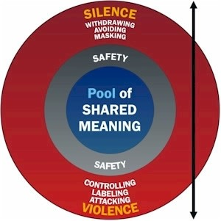

Slide 6
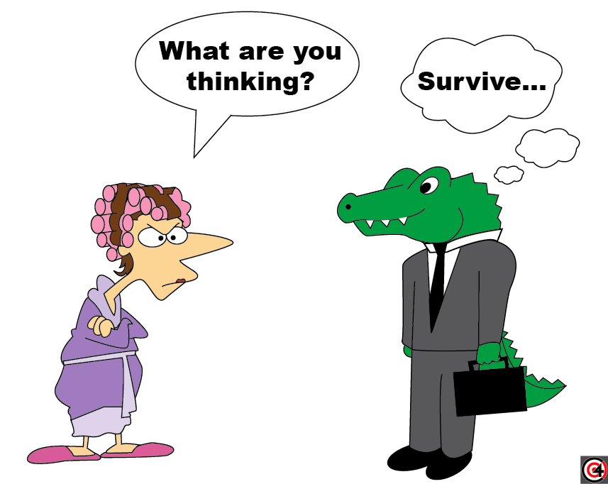

Slide 7
Facts and Stories
What’s the difference?
Good stories
Unhelpful stories
Victim
Villain
Helpless

Slide 9
Let’s practice!
In small groups, describe a person who is…
Disrespectful
Lazy
Unreliable

Slide 10
BREAK

Slide 11
Identifying your Options: Conflict Styles
Jot down what you did of these options a
This could be your preferred conflict style.
In your example conflict,
What did you do?
Give in?
Try to win?
Seek a compromise?
Try and understand the other person’s perspective?
Ignore or side-step issue?

Slide 12
Assessing Your Conflict Style
Most people have one or two preferred styles
Helpful to know that you have other options and the option you choose should be dependent on the results you want to achieve
There is no right or wrong style
Notes:
This can serve as a roadmap of options in any conflict

Slide 13
Conflict Styles
Concern Competing Collaborating
for Self (win/lose) (win/win)
Compromising
(win/win) (lose/lose)
Avoiding Accommodating
(lose/lose) (win/lose)
Concern for Others
Notes:
Thomas-Killman Conflict Mode. Researchers have found that people have one or two preferred styles of managing conflict (combination of nature and nurture / personality and familial norms) and will react and engage in conflict our of habit.
Lots of emotion with conflict (thinking and experiencing emotion difficult to do at the same time) so habit kicks in – no conscientious choice about how to manage the conflict.
By themselves each style is not judged to be “better” or “worse” than the other. (although as Ombuds we tend to value “collaboration” above the others).
13

Slide 14
AVOIDING
How do people act when using this style?
Diplomatically side-step the issue, ignore, hide, procrastinate, deny there is a problem
When would you use this style?
When it isn’t important to you, not worth it to engage
When wouldn’t you use this style?
When the conflict continues, no one’s needs are being met

Slide 15
ACCOMMODATING
What behaviors are present with this style?
Smiling, listening, giving in, obeying, apologizing
When would you use this style?
It’s not that important to you, not necessary to understand other person’s interests
When wouldn’t you use this style?
A fast decision is needed, not a lot of commitment involved in the process

Slide 16
COMPETING
How do people act when using this style?
Assert their position, debate, shout, interrupt, do not give in, possible physical contact/violence
When would you use this style?
Emergencies, when you are being taken advantage of/manipulated, when you really want to win
When wouldn’t you use this style?
When the relationship takes precedence over your winning

Slide 17
COLLABORATING
How do people act when using this style?
Listen, identify interests, explore issue in depth, find ways to improve relationship
When would you use this style?
Long-term relationships, you have the time to commit to the process, you want a lot of buy-in, involvement
When wouldn’t you use this style?
Time factor, leadership is more important, situation does not require this process

Slide 18
COMPROMISING
How do people act when using this style?
Make concessions, seek to split the difference, find happy medium
When would you use this style?
When you don’t have the time and energy, need for a fast solution, relationship isn’t that important
When wouldn’t you use this style?
When determining interests to enhance the relationship is more important than a quick solution

Slide 19
When to use which style…
How much time to do you have (i.e., does action need to be taken immediately?)
What have you already tried?
How important is the issue to you?
Is there a relationship?
Is there a possibility you are wrong?
Has this ever happened before?
Is there a difference in power?

Slide 20
Scenario:
A co-worker recently stopped friendly conversations with you. You are unsure why. Yesterday, this co-worker came into your office, slammed the door shut behind her, and began screaming at you for not completing an important report. After a few minutes of screaming, she left your office.
What conflict styles have you used? What other options do you have at this point?

Slide 21
Conflict Styles
Concern Competing Collaborating
for Self (win/lose) (win/win)
Compromising
(win/win) (lose/lose)
Avoiding Accommodating
(lose/lose) (win/lose)
Concern for Others
Notes:
Thomas-Killman Conflict Mode. Researchers have found that people have one or two preferred styles of managing conflict (combination of nature and nurture / personality and familial norms) and will react and engage in conflict our of habit.
Lots of emotion with conflict (thinking and experiencing emotion difficult to do at the same time) so habit kicks in – no conscientious choice about how to manage the conflict.
By themselves each style is not judged to be “better” or “worse” than the other. (although as Ombuds we tend to value “collaboration” above the others).
21

Slide 22
DiSC Personality Profile - Teaser

Slide 23
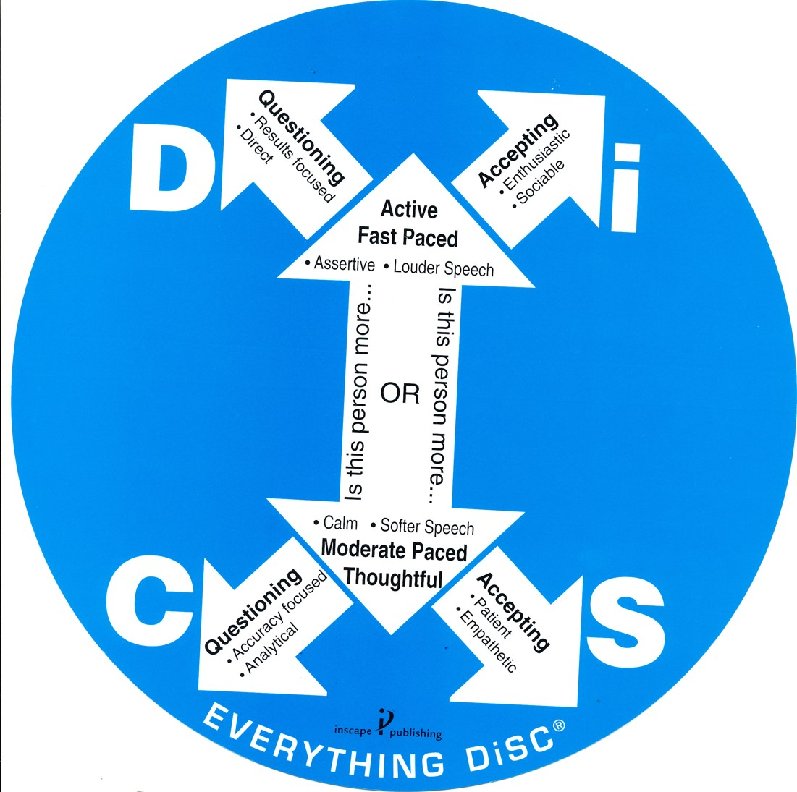

Slide 24
Understanding “D”
Key characteristics of people with high “D” tendencies:
High ego strength
Strong-willed
Decisive, Direct
Efficient, Energetic
Competitive
Independent, Risk-Taker
Practical, wants bottom-line answers
Likes to take charge, be in charge
Active and in a hurry

Slide 25
Understanding “i”
Key characteristics of people with high “i” tendencies:
Optimistic
Enthusiastic, Emotional
Persuasive
Animated, Fun-Loving
Very Verbal, Talkative, Lots of stories
Involved with people
Stimulating, Entertaining
Very Outgoing
Active

Slide 26
Understanding “S”
Key characteristics of people with high “S” tendencies:
Patient, Loyal
Good listeners
Team Player
Relaxed, Easy-going, Friendly
Speaks softly
Calming influence
Supportive
Reserved
Prefers stability, methodical approach

Slide 27
Understanding “C”
Key characteristics of people with high “C” tendencies:
Gives attention to high standards, perfectionist
Accuracy, Analytical thinking
Persistent
Quality control, Very detailed
Responds with caution
Speaks without emotion
Precise, Diplomatic
Reserved with expressions and feelings
Prefers a lot of information, Factual
Uses indirect approaches to conflict

Slide 28
Name that style: email decoding
Formal, detailed, serious
Happy tone, ☺ , colors
States purpose, brief notification
Friendly, methodical approach

Slide 29
CASE STUDIES

Slide 30
We Are Here to Help!
The Ombuds Office is on both campuses:
Anschutz – Building 500, Room 7005C
Denver – LSC, Room 1003
www.ucdenver.edu/ombuds

