Slide 1
Advanced Post Award
Presenters:
Robby Rigby
Stephanie Chandler-Thompson
Liz Lee
Lauren Rogers

Slide 2
Day-to-Day Post Award
Award receipt
Re-budgeting
Payroll on Sponsored Projects
Procurement
Monthly Reconciliation
Cost Transfers / Journal Entries
Projections / Forecasting
No-Cost Extensions
Award Closeout

Slide 3
Award Receipt
Notice of Award
Budget and Project Periods
Award Payment(s)
Special Terms and Conditions
Reporting Requirements
Contacts
Review setup to ensure accuracy
Budget loaded
Billing type

Slide 4
Re-budgeting
Reduced Award
Work with PI to adjust award
Communicate budget changes to OGC
Re-budgeting during project period
Determine if re-budgeting requires prior approval
NIH
Equipment over $25,000
Key Personnel effort reduction of >25%

Slide 5
Payroll on Sponsored Projects
Effort
Ensure funding of personnel on project matches effort reported
Certifying effort through ePERS system
Done at the end of each semester
Funding Distributions
Confirm lab staff effort with PI
Reconcile HCM funding distributions to ensure they match effort
Adjust funding distributions at the project closeouts to avoid payroll suspense

Slide 6
Procurement
MarketPlace & Concur Systems
Ensure accurate allocation of supplies for projects
Standardize naming conventions in Concur PCard expense reports
Business Purpose = GL Item Detail
Allocation Methodology
Multiple Projects in Lab
NIH GPS Section 7.6 states “In general, a cost that benefits two or more projects or activities in proportions that can be determined without undue effort or cost should be allocated to the projects on the basis of the proportional benefit.”

Slide 7
Monthly Reconciliation
mFIN Financial Detail Report
Run through account codes
Identify any unallowable expenditures
Provide mFIN Financial Detail Report to PI
They can identify expenses that may not related to their project
Complete Journal Entry to move any unallowable expenditures
Best Practices:
Complete reconciliation monthly
Remove unallowable expenses within 90 days
Reconcile entire project period expenses at closeout

Slide 8
Cost Transfers
Journal Entries & PETs
Ensure proper details for the Journal entry or PET
Why the expense hit the incorrect speedtype, where the expense is being moved to, what has been done to avoid error in the future
PETs will require information about employee and their effort on projects
Provide substantial documentation supporting cost transfer
mFin Financial detail showing the error, payroll documentation for PETs
Emails approving the cost transfer or supporting transfer
If transfer is over 90 days more documentation justifying transfer will be required

Slide 9
Projections & Forecasting
Fiscal Cliff Identification
Provides PI with better understanding of future finances to allow them to make more sound business decisions.
Future hiring
Ramp up grant applications
Reducing expenditures (animals, lab supplies, lab staff)
Current project budget period projections
Forecasting up to five years out

Slide 10
No Cost Extensions
Heading into the end of a project period and funds remain
Confirm the sponsor allows no cost extensions (award notice, grant administration guides, contact grant manager, etc.)
Work with PI to draft NCE request
Need to have scientific justification for NCE
Cannot spend out unobligated balance just because it remains
Route request through OGC. If non-federal award, have approval from the sponsor with the request

Slide 11
Project Closeout and Reporting
Wrapping up the project
Touch base with PI 30-60 days prior to end of project to begin ending project.
Reconcile expenses
Reconcile cash balance
Reconcile PO encumbrances
Remove unallowable expenses
Work with PI to ensure final status report and any other closeout reports are completed
Work with OGC Post Award Specialist to complete final financial reports
If a billable project, work with billing on final invoice

Slide 12
Roles and Responsibilities for Sponsored Project Administration-Postaward
Office of Grants and Contracts
Presenter: Stephanie Chandler-Thompson

Slide 13
Roles and Responsibilities
The Office of Grants and Contracts is responsible for ensuring proper review of sponsored project proposal submissions and stewardship of awarded funds in partnership with Departmental Administrators and Principal Investigators
Grants management is a collaborative effort between the OGC units and the departments, therefore the following is intended as a framework and the duties are continually reviewed to determine if changes are needed

Slide 14
Roles and Responsibilities – Post Award/ Closeout Unit
Secondary review of new award set ups and award modifications
Review and entry of milestone deliverables and dates for all new award setups and modifications
Review and approval of Payroll Expense Transfers (PETs) and non-personnel journal entries impacting sponsored projects
Tip- Required documentation should be attached to the PET and detail on the summary page is the key for the approval of the PET
Review of pre-award and post term expenditures (after the budget period) for allocability and allowability to the sponsored project period

Slide 15
Roles and Responsibilities-Postaward/Closeout Unit
Provide guidance on sponsored terms and conditions and UCD procedures to ensure proper compliance and stewardship of sponsored funds
Preparation of financial reports for submission to sponsoring agencies as the official institutional signatory in conjunction with departmental review
Tip- If the department creates the financial report, it must be reviewed by the Office of Grants and Contracts and vice versa.
Review of final invoices in collaboration with department administrators and the Billing Team
Confirmation of carryforward balance for sponsor prior approval requests
Confirmation of sufficient funds for no-cost extension requests

Slide 16
Roles and Responsibilities-Postaward/Closeout Unit
Review of relinquishing statements and confirmation of forecasting unexpended balances
Tip-Timing is important when submitting the request.
Review and approval of XTrain termination notices and accuracy of trainee and fellowship stipend expenses
Tip-The total amount paid to the trainee must match the termination notice.
Processing of mid-term budget revisions

Slide 17
Roles and Responsibilities-Postaward/Closeout Unit
Set up of cost share speed types
Reduction of carryforward budgets from prior year projects in Peoplesoft; increases are processed by the Award Setup team
Review and approval of subcontracts and Purchase Orders in CU Marketplace in conjunction with contract amendments and availability of project funds
Review and monitoring of cost share on sponsored projects

Slide 18
Roles and Responsibilities-Principal Investigator (PI)/Departmental Administrator
Review of new award set ups and Award Modifications
Tip- When you receive your notification of the award set up or Award Modification, this is the time to review to verify if changes are required
Submission of funding distributions and Payroll Expense Transfers (PETs) to properly allocate employee effort to sponsored projects
Tip- Timing is key so that payroll does not go into suspense
Review and certification of effort for sponsored projects (3 cycles per year)
Processing of non-personnel transactions in CU Marketplace/Concur

Slide 19
Roles and Responsibilities-Principal Investigator (PI)/Departmental Administrator
Submission of journal entries to correct identified errors in non-personnel expense allocations
Tip-The back up documentation and journal entry description is required.
Monthly monitoring of expenses on all sponsored projects to ensure accuracy and adherence to budget limitations
Tip-The review of the expenses frequently is key to project management.
Subrecipient Monitoring-Tracking and approval of invoices, verification with Principal Investigators work is being conducted according to scope, preparation of agreement and amendment requests to OGC contracts
Review of 90, 60, 30 and 30, 60, 90 day reports to confirm projects approaching the end date and terminating projects

Slide 20
Roles and Responsibilities-Principal Investigator (PI)/Departmental Administrator
Preparation of carryforward requests (justification and detailed budget) and routing to OGC
Routing of no cost extension (NCE) request and justification of OGC 10 days prior to budget end date
Communication to laboratory/research staff of appropriate Project numbers/speed types for sponsored awards
Ensure cost share requirements are met according to sponsor terms and recorded appropriately within cost share speed types

Slide 21
Roles and Responsibilities-Principal Investigator (PI)/Departmental Administrator
Removal of outstanding expenses not reported to the Sponsor via PET or journal entry
Closure of open Purchase Orders (POs)/encumbrances
Completion of the Fixed Price/Clinical Trial Closeout form
Prepares equipment disposition reports and submits to OGC

Slide 22
Roles and Responsibilities-Principal Investigator (PI)/Departmental Administrator
Review of final invoice for submission to the sponsor
Submission of a closeout request with appropriate back up documentation
Preparation of final invention statements for routing to OGC
Monthly review of financial statements
Monitoring of clinical trial and any department billed contracts to ensure that invoicing and payments have occurred

Slide 23
Question and Answer

Slide 24
Resources
Campus Administrative Policy
Roles and Responsibilities for Sponsored Project Administration, 4-13

Slide 25
Advanced Post Award Elizabeth Lee, CLAS, Post Award Specialist

Slide 26
Overview
Advanced post award
Financial Management
CU-Data: tools for financial management
Managing Budgets & Planning for the Future
Effort on Sponsored Projects
Billing, Invoicing, and Drawdowns
Subrecipient monitoring

Slide 27
Financial Management: Overview
Advanced post Award
Budget vs. Cash Management
Financial Management Tasks
Tools for Financial Management

Slide 28
Budget vs. Cash Management
Financial management
Sponsored projects, unlike other university fund sources are not budget or cash based, but instead they are often both budget and cash based.
This impacts how they are managed and what types of tasks are necessary to ensure compliance with sponsor policies and successful management of the funds.

Slide 29
Budget vs. Cash Management
Financial management
Most sponsored projects are cost reimbursable (will discuss this more under the billing section). This means we need to incur expenses before the sponsor will pay us.
This requires that we manage the project consistent with the sponsor approved budget, and often run a cash deficit month by month, as we invoice the month after we incur the expense(s).

Slide 30
Budget vs. Cash Management
Financial management
Even though we are generally managing to the planned budget the sponsor agreed to in the notice of award or contract, we must also monitor the cash position of the project, to ensure invoices are being paid.
This becomes particularly important as we approach the project closeout or if specific invoice deliverables are required by the sponsor (i.e. invoice frequency)

Slide 31
Budget vs. Cash Management
Financial management
Some projects are paid in advance as opposed to cost reimbursable. This means the sponsor has paid the entire balance of the award/contract up front.
However, we still need to manage the budget to ensure that expenses are allowable.

Slide 32
Budget vs. Cash Management
Financial management
Sponsors may have different pay schedules (i.e. quarterly installments, deliverable based, etc.). It is important to understand how your sponsor has awarded your project to be compliant and ensure proper payments.

Slide 33
Financial Management Tasks
Financial management
Variable department sizes will impact what types of financial management services department administrators can provide.
Certain tasks are mandatory to ensure compliance and proper sponsored project management.

Slide 34
Financial Management Tasks
Financial management
Though tasks fluctuate and depend on department resources, certain items should appear on all research administrators to-do lists:
Reconciliation of expenses
Evaluation of project budget position
Review of cash position of project

Slide 35
Financial Management Tasks
Financial Management
Reconciliation
Each month (at a minimum) a fiscal staff person with a direct knowledge of allowed expenses must review all expenditures on sponsored project speedtypes. To identify erroneous charges, missing charges, inaccurate or improperly allocated charges.
Budget
Fiscal staff must track budget to ensure sponsor compliance and understand burn rate.
Cash Position
Ensure invoices/draws are happening timely and accurately. Pay particular attention as projects approach closeout

Slide 36
Tools for Financial Management: CU-Data
Financial management
Frequently used reports
m-Fin Financial Detail
m-Fin Trial Balance Summary
m-Fin Operating Summary
m-Fin Payroll Transactions
m-Fin Award
m-Fin Project Speedtype One-Liner
m-Fin Abnormal Balance
and many others

Slide 37
Managing Budgets & Planning for the Future
Advanced post award
Differences Between Budgets & Actual Expenditures
Rebudgeting
Encumbrances & Projections
Preventing Overspending
Beyond the Current Project: Cliff Identification

Slide 38
Differences Between Budgets & Actual Expenditures
Managing budgets & Planning for the future
At the time of proposal, Pre Award managers and Principal Investigators do their best to budget according to what they need to accomplish
However, when awards are made, some changes may take place (i.e. travel cost changes, salary increases, differing needs, unexpected costs)
As a research administrator it is your job to manage these changes and keep project compliant and within budget

Slide 39
Rebudgeting
Managing Budget & planning For The Futrue
Internal Rebudgets
OGC will set up an outline of the sponsor approved budget at the time the speedtype is set up. This budget can be reallocated slightly to accommodate additional account code details from initial budget.
Sponsor Approved Rebudgets
If changes to budget occur, sponsor approval may be necessary (see sponsor terms and conditions). If a sponsor approves a rebudget, work with OGC to complete rebudgeting process, similar to initial rebudget described above.

Slide 40
Encumbrances & Projections
Managing budgets & Planning for the future
Different methodologies for planning use of project funds:
Encumbrances are a university tool to help us account for planned future expenses (i.e. payroll, subcontracts, indirect costs)
Projections are individualized, good for grant managers to be able to know expenses well enough to project future expenses and understand project burn rates.

Slide 41
Preventing Overspending: Identifying issues before they arise
Managing budgets & Planning for the future
Encumbrances allow sponsored project administrators to identify possible overspending ahead of time.
Projections & Burn Rate Analysis allows administrators to track and plan for the project lifetime to ensure enough funding is available to execute the project scope and specific aims on the planned schedule.

Slide 42
Beyond the current project: cliff identification
Managing Budgets & Planning for the Future
Many principal investigator salaries and lab support costs depend on externally sponsored research
Each PI and administrator is responsible for understanding the forecasted future expenses (beyond currently active projects) to help PI’s plan for future proposals and manage costs when funding sources expire
Each department will have unique processes to track these costs, but understanding a PI/lab burn rate is important to this process

Slide 43
Effort On Sponsored Projects: Overview
Advanced post award
Paid Salary
Sponsor Definitions of “Effort”
University Definitions of “Effort”
ePERS
How ePERS are calculated
Employee Types
9-month and 12-month appointment types
Tools for managing effort on sponsored projects

Slide 44
Paid Salary
Effort on sponsored projects
When approved by sponsor
Understanding the “salary” to “effort” connection
Sponsors typically track “effort”
Salary and benefit costs can vary from original budget, so it is important to understand how sponsor tracks “effort” or “salary” to be complaint

Slide 45
How Sponsors Track “Effort”
Effort on sponsored projects
NIH: tracks effort in “months” (calendar, academic, summer), reported annually in RPPR
Variances in effort may require sponsor prior approval
Salary cap applies
NSF: typically also tracks months, limits allowable maximum effort
Other sponsors may track percentage of effort or salary paid on grants – dependent on RFPs, sponsor terms and conditions

Slide 46
How the University Tracks “Effort”
Effort on sponsored projects
University tracks effort as paid salary on grants (or cost-share committed salary)
Effort is reported and certified through ePERS based on the amount the employee is paid and what percentage is paid on the sponsored funds

Slide 47
ePERS Reports
Effort on sponsored projects
ePERS are reports that each paid employee on sponsored projects must certify within 120 days of end of semester.
ePERS are calculated based on the amount paid to the employee during the semester and the amount paid on the sponsored project.
Note: ePERS are not certified for people paid outside of the HCM system (vendors, contractors, subcontractors, etc.) but tracking effort may be necessary for sponsors

Slide 48
9-month or 12-month appointments
Effort on sponsored projects
Typically, faculty at AMC have 12-month appointments
While faculty on the DDC have 9-month appointments
Important to keep this in mind when budgeting a project with both types of appointments (9-month faculty base appointments will need to be adjusted to reflect a 12-month base salary for some budgets)
Note that encumbrances may be impacted by employee appointment type (i.e. summer appointments are frequently not encumbered until the appointment is entered by HR staff)

Slide 49
Tools for Managing Effort on Sponsored Projects
Effort on sponsored projects
HCM
CU-Data ePERS Reports (in the ePers folder in CU-Data)
ePERS Summary by ORG
ePERS Summary by PI
Uncertified ePERS by ORG or Campus
More coming soon!

Slide 50
Billing, Invoicing, and Drawdowns
Advanced Post Award
Cost Reimbursable & Advanced Pay
Sponsor Drawdowns
OGC Invoiced
Department Invoiced
Installment Based
Billing Types
Tools for Managing Cash

Slide 51
Cost Reimbursable & Advanced Pay
Billing, invoicing, and drawdowns
As discussed earlier in this presentation, awards can be cost reimbursable or advance pay or occasionally installment/interval based
Depending on how a project is set up, different billing requirements are typically in place
OGC handles most types of billing and drawdowns
Awards can be cost reimbursable (accrual based)

Slide 52
Sponsor Drawdowns
Billing Invoicing and Drawdowns
For major federal sponsors (NIH and NSF), OGC staff draw funds directly from sponsor, through online systems.
The funds must be drawn down to exactly match billing period expenses. This process is typically conducted monthly.

Slide 53
Billing Types
Billing, invoicing, and drawdowns
CR – Cost Reimbursable
LC – Letter of Credit
IB – Installment Based
FR – Fixed Rate
You will see these billing types listed on m-Fin reports in the report header

Slide 54
Cost Reimbursable Billing: OGC Invoiced
Billing, invoicing, and Drawdowns
Most other projects are billed by OGC directly (on schedule established by sponsor, typically monthly)
OGC creates an invoice based on expenses posted to speedtype during the billing period and sends the invoice directly to the sponsor
Sponsor will remit payment to OGC per the terms and conditions of award (usually within 30 days)
Important to manage invoices, particularly as projects approach closeout to prevent cash deficits!

Slide 55
Cost Reimbursable Billing: Department Invoiced
Billing, invoicing, and drawdowns
Sometimes departments will bill sponsors directly; however department still needs to send a copy of invoices to OGC!
This is typically necessary for unusual payment schedules or if deliverables are required for sponsor to issue payment
Be sure to track this closely and manage invoice payment
Payments should still be remitted to OGC
If checks are received by department, ensure they are sent to the proper person and OGC and tracked in project files
*Occasionally the department will invoice for installment based billing (next!)

Slide 56
Installment Based Billing
Billing, invoicing, and Drawdowns
Occasionally projects are paid up front or on a deliverable schedule.
This may or may not require an invoice, but typically invoices if necessary are less detailed (do not include expense information)
Sponsor may still require financial reports or other deliverables
Residual/unspent cash on projects at end date may need to be returned to sponsor (dependent on policies)

Slide 57
Tools for Managing Cash
Billing, invoicing, and Drawdowns
PeopleSoft Queries
BILLING_INQUIRY_BY_PROJECT
UCD_AR_OA_HOLDINGS
CU-Data Reports
m-Fin Payments Received
m-Fin Receivables Activity
m-Fin Financial Detail (asset/cash account code ranges)

Slide 58
Subcontracts and Subrecipient Monitoring
Advanced post award
Why subrecipient monitoring is necessary
Examples of Subrecipient Monitoring

Slide 59
Why monitoring is necessary?
Subcontracts and Subrecipient monitoring
As the pass through entity for funding, we are responsible for ensuring sponsor policies are being met at subcontract sites
To do this, close review of subrecipient invoices and tracking of subrecipient progress is necessary

Slide 60
Examples of Subrecipient Monitoring
Subcontracts and subrecipient monitoring
Keeping contact logs of communication with subrecipient site\
Recommended that the PI do this
Review invoices for unallowable expenses, unexplained variances in monthly invoice totals
Ensure invoices are sent to PI or project staff (rather than directly to AP Invoice)
Ensure PI or other fiscal staff who overview subcontract progress approve invoices before payment is issued
Ask subcontractors to report effort, other research progress as necessary

Slide 61
Questions?

Slide 62
Advanced Post Award
Project Closeout & Reporting

Slide 63
Agenda
Project Closeout Timeline
Common Sponsor Reporting
Example Reports
Internal Reporting
Audit
Questions

Slide 64
Project Closeout Timeline
Prior to Project End Date
60 Days
30 Days
90 Days
Do you need more time to complete the project?
Review outstanding PO encumbrances
Review outstanding payroll encumbrances
Ensure all necessary remaining purchases are planned and sufficient funds are available
Review project expenses
Request NCE
Review outstanding items from 90 day section
Review all planned equipment charges have been incurred
No new equipment should typically be purchased at this time
Review outstanding items from 90 and 60 days
Review spending and clear deficits
Verify all invoices have been received and submitted for payment
Notes:
90
Close POs
Update funding
Funding end date cannot be past project end date
Setup final POs if necessary
Burn rate
60
Equipment needs to be used during project period – potential audit risk
30
Make sure all expenses are booked

Slide 65
Project Closeout Timeline
After Project End Date
60 Days
90 Days –
R Status
30 Days –
E Status
Payroll cannot be charged after project end date
New expenses cannot be charged
Invoices for active POs can still be submitted
Expense and travel reports need to be charged within 60 days
PETs need to be charged within 60 days
JEs must be completed within 60 days
Most final reports and invoices due at 90 days
Unspent funds returned
Review all ePERs for accuracy and certification
Notes:
30
For POs already setup in Marketplace invoices can still be submitted – however new POs cannot be setup
No new purchases on procurement cards
No new travel
60
PETs
When a PET is completed the fringe does not show on financials until month end close. Be sure to process PETs with enough time to allow for these charges to get them on invoices
Timeline may need to be shifted if reports and invoices are due before 90 days

Slide 66
Project Close Out Resources
Notes:
OGC sends out both 90-60-30 and 30-60-90 reports

Slide 67
Sponsor Reporting
Types
Project/Technical
Financial
Invention Statements
Property/Inventory/Equipment
Frequency
Monthly
Quarterly
Semi-Annual
Annual
Final
**Reporting requirements should be in NOA
Notes:
Reporting requirements and deadlines should be in notice of award – always look for this when project is awarded and set yourself reminders!! Don’t rely on OGC or PI to meet deadlines
Make sure you’re using correct forms
Allow enough time for moving expenses, review and signatures

Slide 68
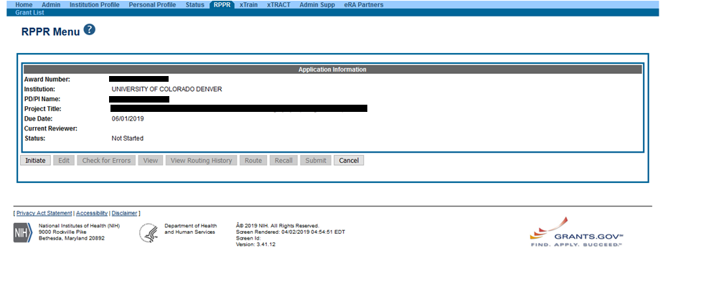
Example – RPPR
Notes:
RPPR – Research Performance Progress Report
Completed in eRA Commons
E-mail notification will be sent to PI 120 days prior to due date

Slide 69
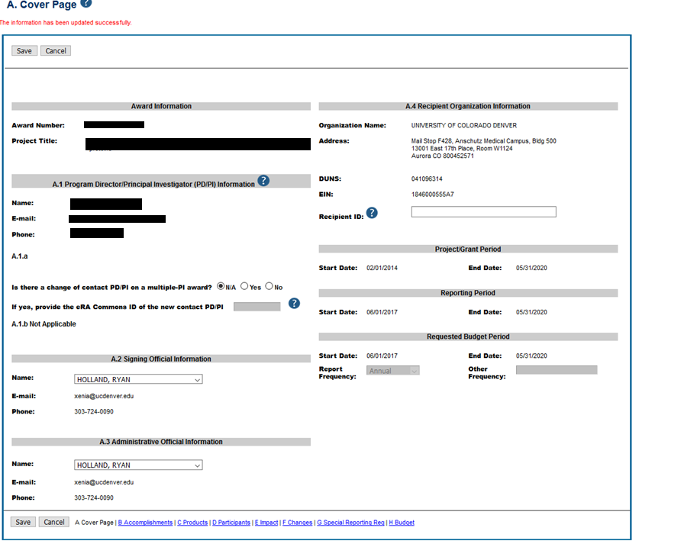
Example – RPPR
Notes:
RPPR – Research Performance Progress Report
Completed in eRA Commons
E-mail notification will be sent to PI 120 days prior to due date

Slide 70
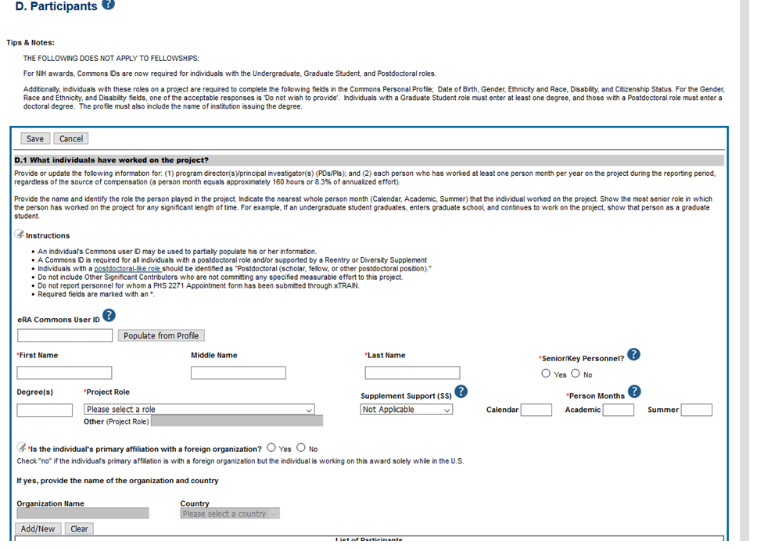
Example – RPPR
Notes:
RPPR – Research Performance Progress Report
Completed in eRA Commons
E-mail notification will be sent to PI 120 days prior to due date

Slide 71
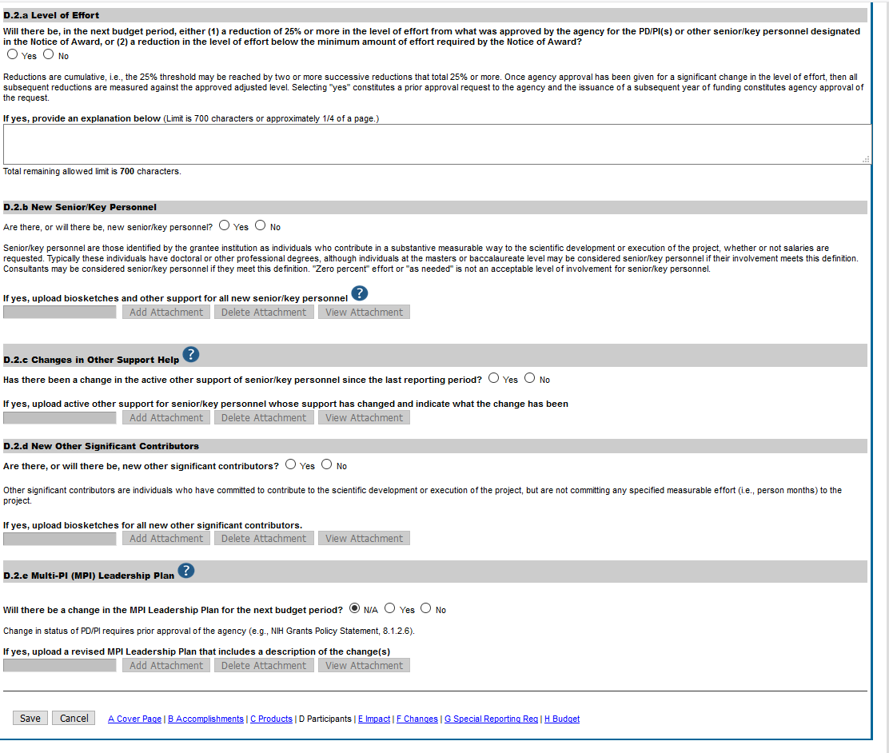
Example – RPPR
Notes:
RPPR – Research Performance Progress Report
Completed in eRA Commons
E-mail notification will be sent to PI 120 days prior to due date

Slide 72
RPPR Flowchart

Slide 73
RPPR Reminders
Not all RPPRs need to be routed
Annual RPPR needs to be routed due to financial requirements
Final RPPR does not need to be routed – no financial information
Interim RPPR – depends if financial information is required and may have already been routed
OGC must receive RPPR 12 business days prior to due date. This does not include approval flow before it gets to OGC
Conflict of Interest (COIs) must be completed for all personnel – including students
eRA Commons IDs – make sure all IDs are setup
NIH Information on RPPRs - https://grants.nih.gov/grants/rppr/index.htm

Slide 74
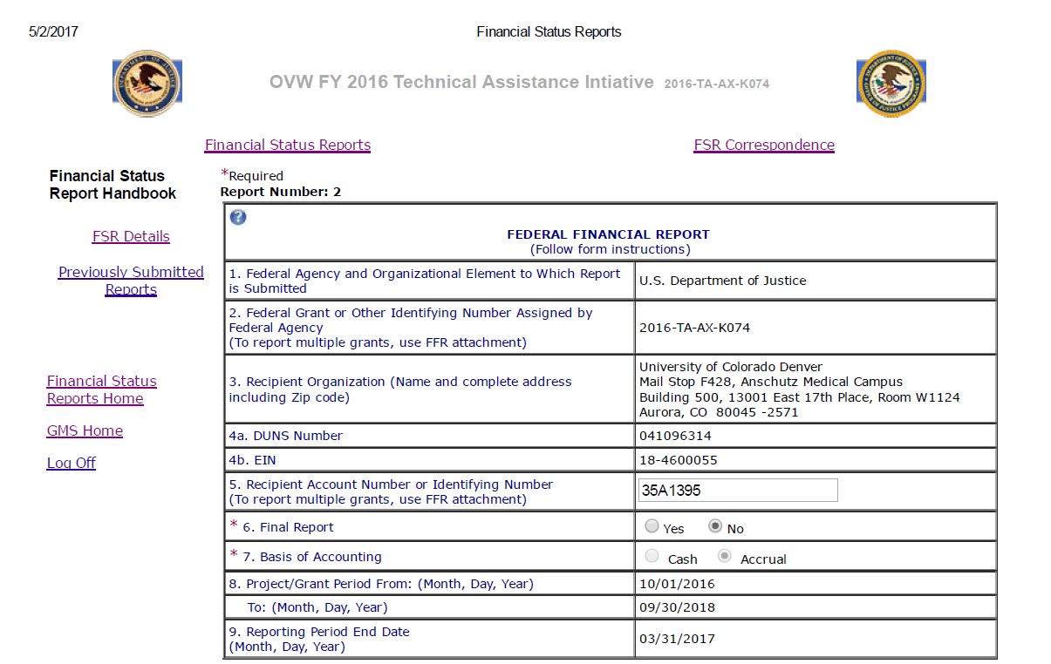
Example – SF425/FSR/FFR
Notes:
FSR – Financial Status Report
FFR – Federal Financial Report
OGC PostAward should complete and Department should review
Quarterly and semi-annual reports due 30 days after reporting period
Final Reports due 90 days after grant period
Can be completed in sponsor portal (ie – GMS)
If sponsor doesn’t have a financial report template this format is typically used

Slide 77
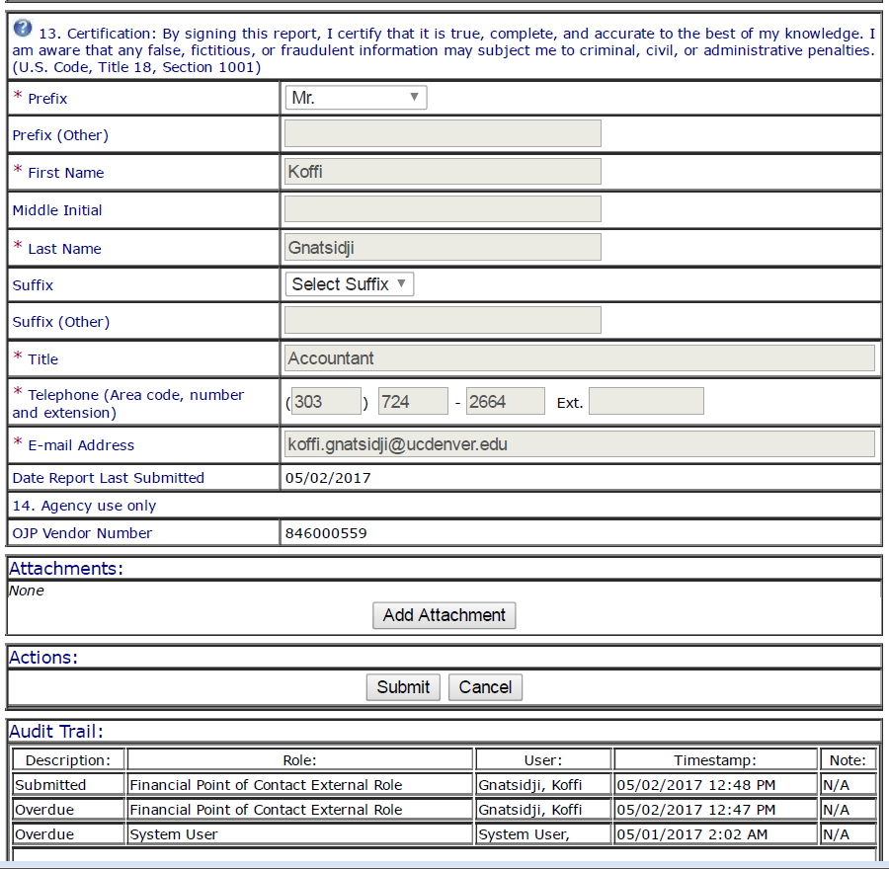

Slide 78
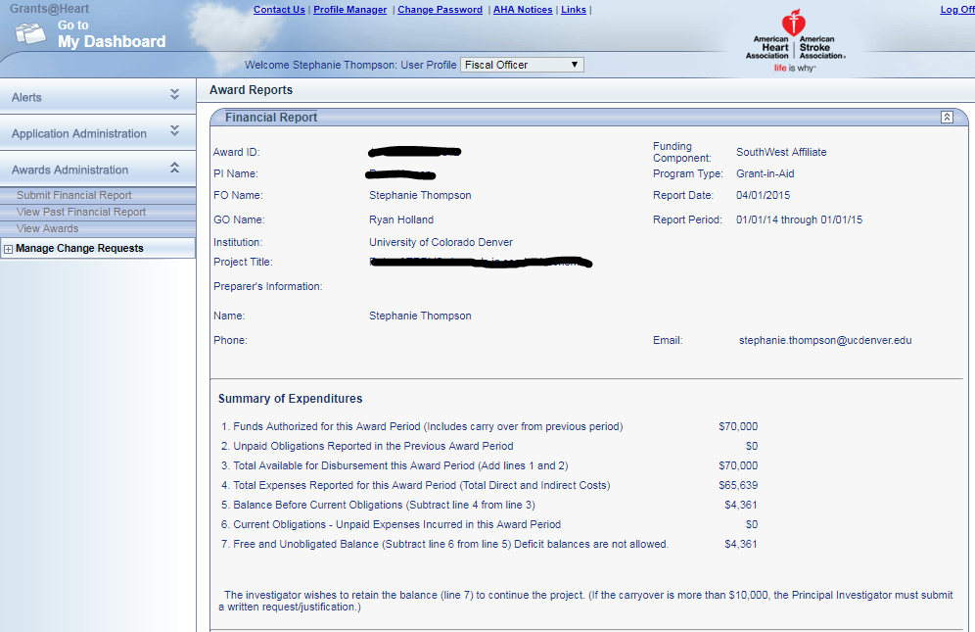
Example – American Heart Assoc.

Slide 79
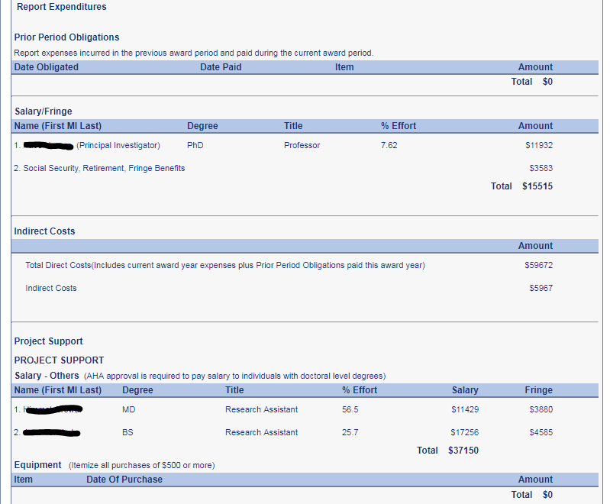

Slide 80
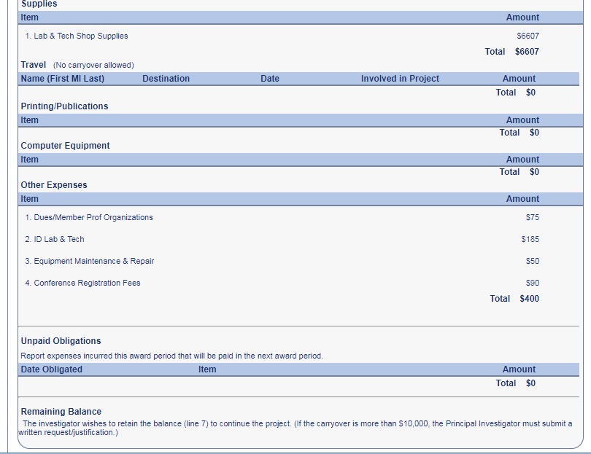

Slide 81
OGC Report Resources
http://www.ucdenver.edu/research/OGC/awardadmin/preaward/Pages/procedures.aspx
http://www.ucdenver.edu/research/OGC/awardadmin/postaward/Pages/CloseoutProcedures.aspx
Notes:
Contact your PostAward admin for help with reporting and any questions
Always try to allow for enough time
Start prepping for reporting well in advance

Slide 82
Internal Reporting
ePER – Electronic Effort Report
Required that all employees paid on sponsored projects certify their effort 3 times/year
Effort should accurately reflect work hours on sponsored projects and many employees will have multiple sponsored projects they are paid from at any time
ePER will include effort across all positions for employee even if one position has no sponsored project effort
Supervisor certification may be required if employee cannot be contacted to certify (usually due to graduation, termination, etc.)
Helpful CU Data Reports: Uncertified ePERs by ORG and ePERS Summary by PI
Notes:
Pass out ePER handout

Slide 83
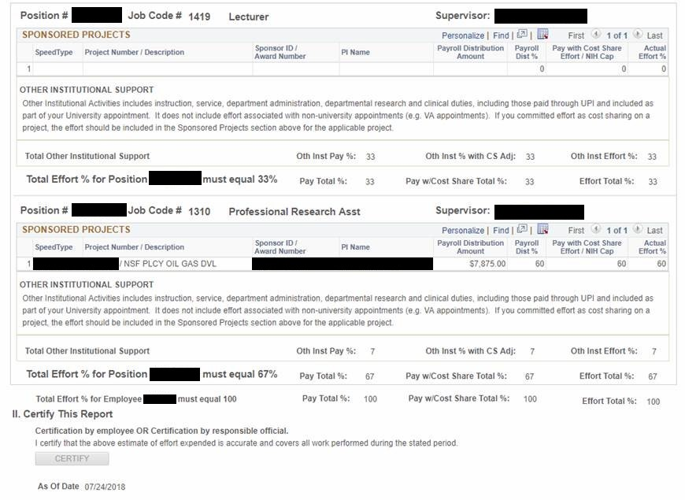
ePER Example

Slide 84
Internal Reporting
COI – Conflict of Interest
Required of all UCD Faculty (Asst. Professor or higher), personnel on an IRB and key personnel on a grant, research committee members, staff who negotiate or execute research agreements on behalf of UCD, area/program administrators, and UCD officers
Must be submitted annually or within 30 days of a change
To disclose, complete the Conflict of Interest and Commitment Disclosure Form at https://era.cu.edu
COI Resources: http://www.ucdenver.edu/research/ORC/COI/Pages/default.aspx

Slide 85
Audit
Frequently Scrutinized Items
Property inventory records. Is the equipment located in the location identified on the property records, is the property in the condition the inventory records indicate, and is the property properly tagged.
Subrecipient monitoring records. Are our PIs keeping records of when the communicate with their subs, are we recording when we receive reports from our subs and were they on time?
Large number of cost transfers.
Documentation. Are we maintaining all of our records, including: receipts, prior approvals from sponsors, etc.
Travel. Are there records for who traveled, when, and are we verifying the reimbursed travel is for the travel necessary for the award. (For example, if a PI rents a car, are we obtaining the recipients that shows who was authorized to drive the car, when was the car rented, and does the mileage make sense for their travel.)
Cost Share. Verify that cost share is appropriately tracked, and that other sponsored funds are not supporting cost share for another project.
Time and effort. Some items that are looked at: are employees following university policy for timely certification and are their ePers accurate.
Meals. Are the meals necessary for the project and are the prices reasonable (ie: are the costs in-line with the GSA M&I rates). This is especially important for NSF, they are really particular about meals.
Participant Support Costs. Are allowed, are they classified accurately, and charged to the correct budget category if allowed.
Large purchases of supplies near the end of a period of performance
Administrative costs. For administrative and clerical salaries to be charged directly to an award, we have to meet the four requirements identified in 2 CFR 200 – which is extremely rare for our university.
Consistency. Are we consistently charging costs as either direct or indirect (most this may come up as general purpose equipment
Contact Barbara Hayes, barb.hayes@ucdenver.edu, if you are contacted by a sponsor announcing a site visit, desk review, or audit

Slide 86
Questions/Comments

