Slide 1
Finance Committee
Biennial Sustainability Reports
May 26, 2022

Slide 2
Introduction
Using update to Campus Master Plan to inform other planning efforts, including Energy Master Planning and Climate Action Planning
The State of Colorado Climate Action Plan (developed from HB19_1261) remains guiding document for Greenhouse Gas Emissions reduction planning. New legislation has created several differing goals and baselines that we attempt to adhere to as we plan - expect more are forthcoming
Continued campus community growth and additional facilities are often juxtaposed in reducing natural resource use and absolute GHG Emissions reductions

Slide 3
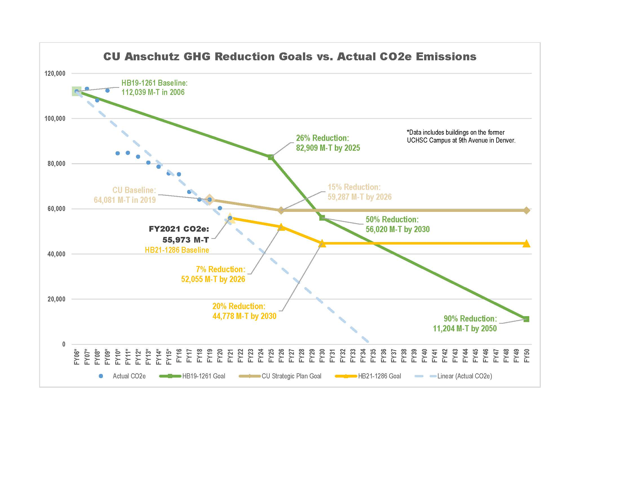
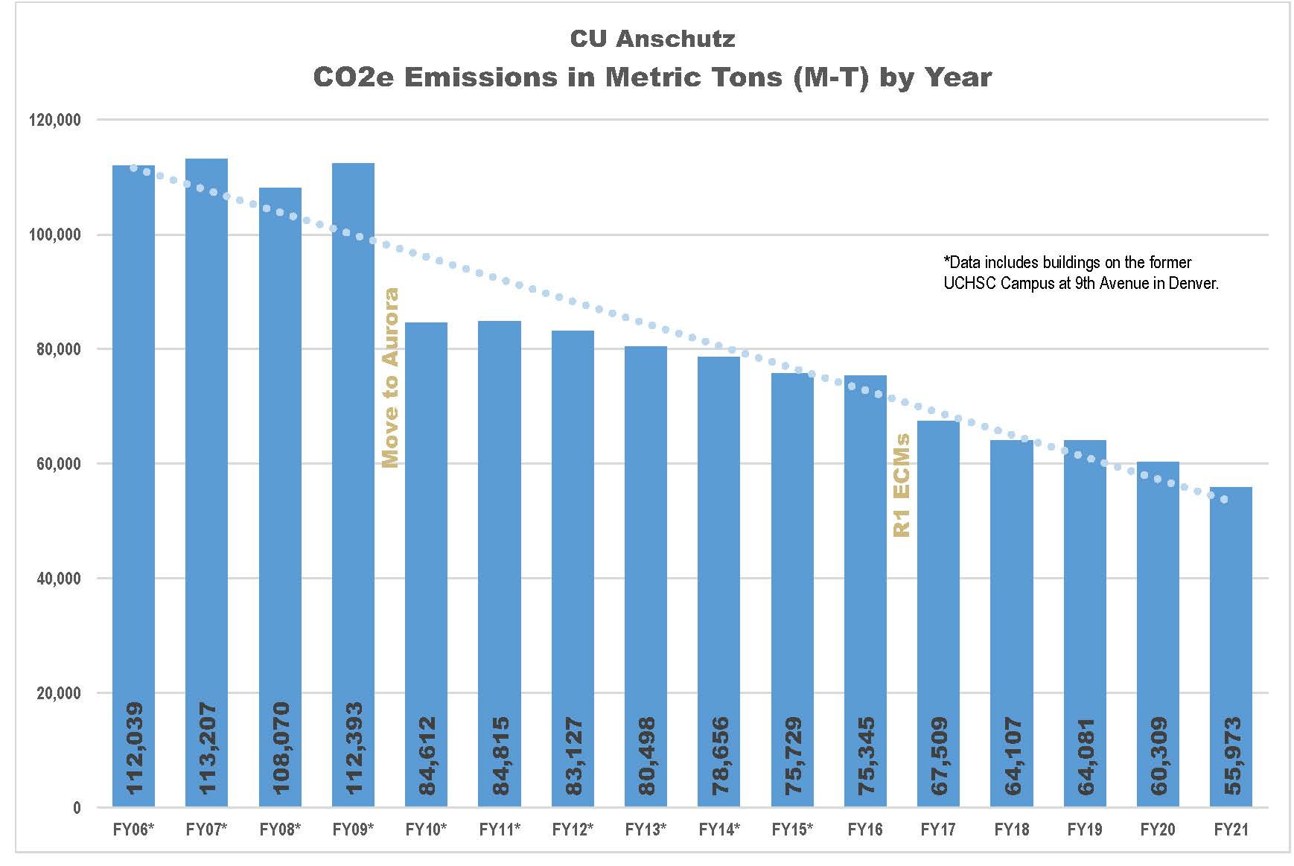
Sustainability Metrics: GHG Emissions
Notes:
Reductions have been realized through a build out of the Anschutz Medical Campus, continuous Energy Conservations Measures (ECMS) on campus facilities and reductions in Xcel Energy’s carbon intensity
Accomplished 2020 goals and are on track to meet 2025, 2026 and 2030 goals. Additional facilities coming on-line will affect the trend in future GHG accounting
Move to Anschutz aided in reducing carbon emissions but there is significantly more square footage, more education and much more research taking place

Slide 4
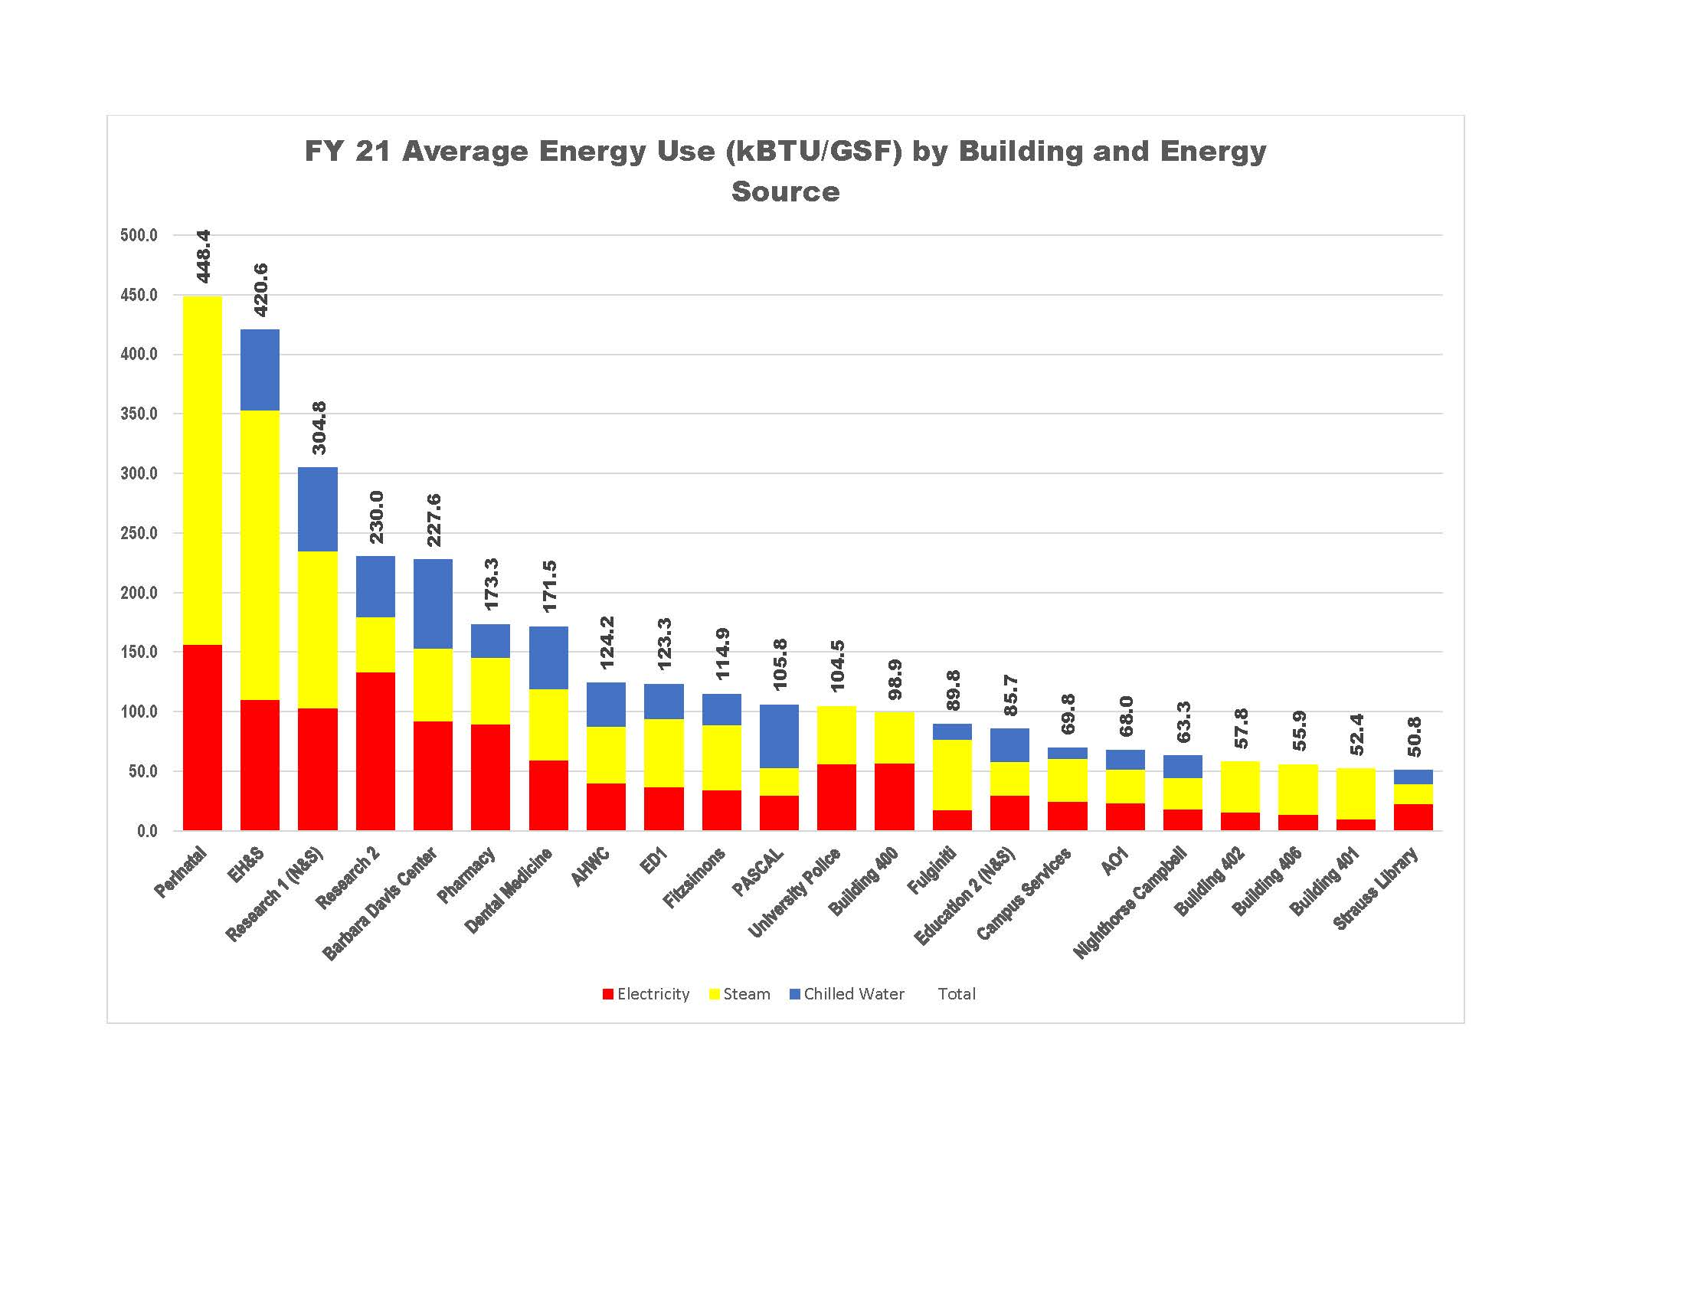
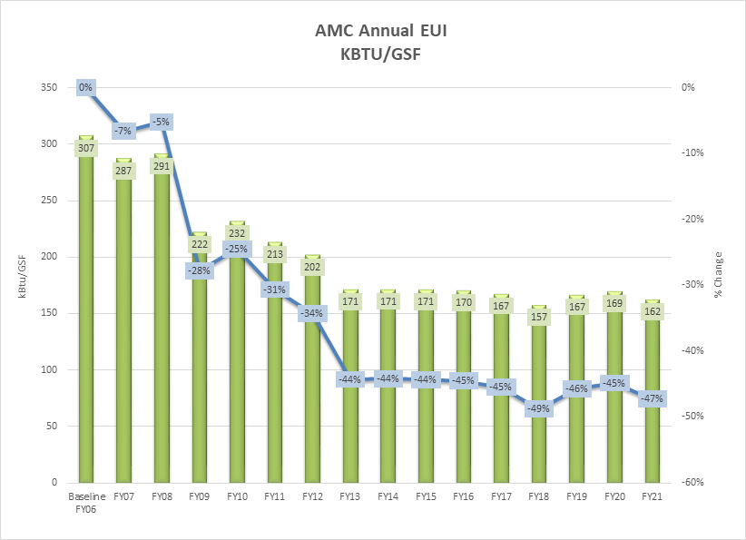
Sustainability Metrics: Energy Use Intensity
R1 ECM Project – completed in 2016, reduced EUI by 165 kBtu/sf
Notes:
EUI/energy per sq. foot has greatly improved on campus with more efficient facilities and ECM’s across campus, especially in research facilities EUI is greatly affected by types of facility, research far and away the most intense users – not to mention some of the largest facilities

Slide 5
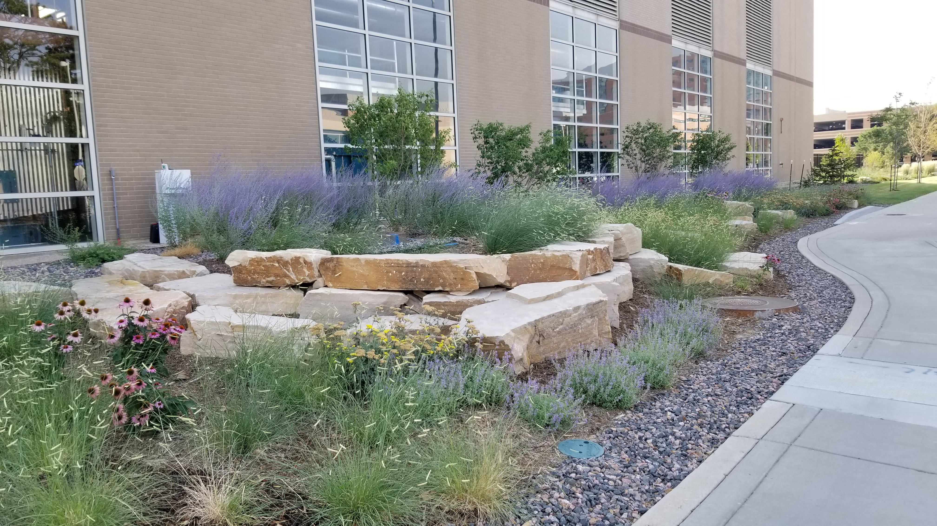
Sustainability Metrics: Water Use
Notes:
Water use has been consistent over time. Grass lawns inherited from Fitzsimmons Army base, irrigation is much more efficient, xeriscaping in place in many areas. New facilities are built with significant water efficiency standards

Slide 6
Sustainability Metrics: Projects of Note
Campus Safety & Emergency Preparedness – 1st Net-Zero Building on CU Anschutz. EUI of 41.8 kBtu/sf, fully electric, utilizes 270 kW solar installation on roof and adjacent parking cover. Seeking LEED Net-Zero certification
Bundled Energy Project – currently in design, est. completion date of Fall 2023. Will save 10,400 mt-CO2-e and $2 million per year in utility costs. 5-year payback
“Whole Campus” Solar Study – if all projects were enacted, would offset 11% of electrical load and save 5,400 mt-CO2 @ cost of $18 million

Slide 7
Community Engagement
Climate & Health Advocacy Sustainability Education (CHASE) - group of diverse graduate students that share a common goal: To increase campus sustainability, advocate for climate friendly legislation, and educate partners on and off campus about the impacts of climate on health
President’s Sustainable Solutions Challenge – 6 entries in 2022, winners addressed composting on campus and developing a “green” revolving fund from donors
Colorado Consortium for Climate Change and Health - The Consortium is an interdisciplinary collaboration of clinicians, biomedical scientists, public health practitioners, epidemiologists, anthropologists, atmospheric scientists, climatologists, and graduate students who share an academic interest in studying the climate change and health nexus
CU Street Medicine - serves the population experiencing homelessness and provide opportunities for medical professional students to have meaningful engagements with said population. CU Street Medicine as a novel way to address the chronic sustainability issues affecting the unsheltered homeless population in Anschutz’s backyard.
Notes:
Some of the student led organizations that addressing different areas of the sustainability umbrella, largely focused on the intersection of climate change, sustainability and public health

Slide 8
Conclusion
CU Anschutz continues to be a leader in the sustainability space for health care and medical research campuses
Challenges remain with the types of facilities that are utilized for healthcare research
Exploring all opportunities and ideas to address sustainability and climate action commitments
Continued growth will hamper efforts at absolute reductions of greenhouse gas emissions but new technologies, advanced facility design, space utilization & remote work, and partnerships with local stakeholders will help us plan for a future where we remain stewards of resources we must use to fulfill the campus mission

