Slide 1
COVID-19: Returning to the Workplace
CDC HVAC Recommendations and Implementation

Slide 2
The following are recommendations for building air handling systems from CDC and ASHRAE.
Inspect the air handling systems to ensure that the outside air dampers are open allowing fresh ventilation air into the building. Set the amount of ventilation air in the building to at least the ASHRAE 62.1-2019 Standard.
Increase the amount of ventilation air in the building to beyond the ASHRAE 62.1-2019 Standard during periods of concern up to the maximum the HVAC system can handle.
Keep the air handler cooling coils, condensate pans, and condensate traps clean and functional.
Recommend Standard air filters-at Least a MERV-13:
Increase the relative humidity in the building to 45-55% RH. At this humidity range 80% of the droplet nuclei viruses lose their infectivity within 15 minutes.

Slide 3
Our Response
Inspect the air handling systems to ensure that the outside air dampers are open allowing fresh ventilation air into the building. Set the amount of ventilation air in the building to at least the ASHRAE 62.1-2019 Standard. We performed scheduled preventive maintenance on all AHU’s on campus.
Increase the amount of ventilation air in the building to beyond the ASHRAE 62.1-2019 Standard during periods of concern up to the maximum the HVAC system can handle. We opened all outside dampers to all AHU’s in each building on campus to their max position that the HVAC system can handle. Will continue to monitor and make adjustments.
Keep the air handler cooling coils, condensate pans, and condensate traps clean and functional. We performed preventive maintenance changing filters and cleaning the coils and drains as needed.
Recommend Standard air filters-at Least a MERV-13 filter: All AHU have MERV-13 or higher filters.
Increase the relative humidity in the building to 45-55% RH. At this humidity range 80% of the droplet nuclei viruses lose their infectivity within 15 minutes. Set-point in most buildings are already at 50%.

Slide 4
Increase the amount of ventilation per ASHRAE
5 Step process:
Building Performance (BP) team- lead and provide a study
Facilities Engineer (FE) team- complete the Powers programming control language (PPCL) modifications
BP-team field verify and take measurements at AHU and VAV
FE/BP team- make adjustments as needed
Monitor load

Slide 8
Air Filters MERV-rating per building

Slide 9
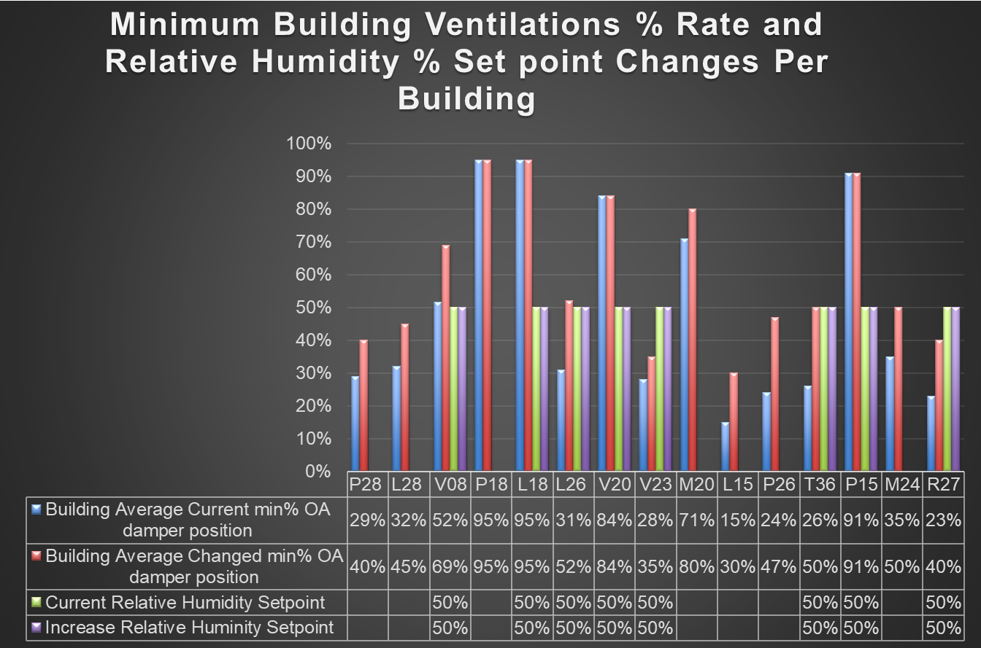
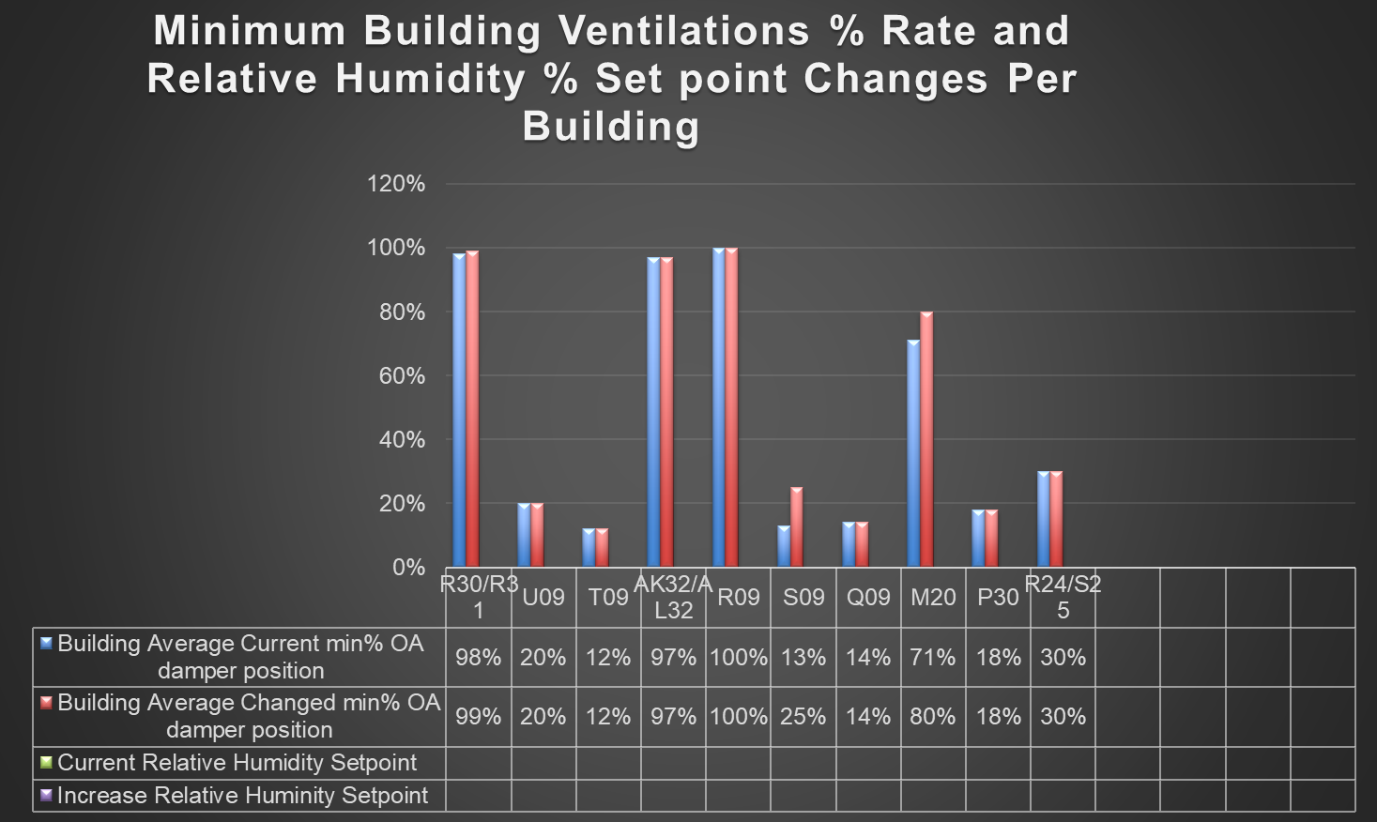
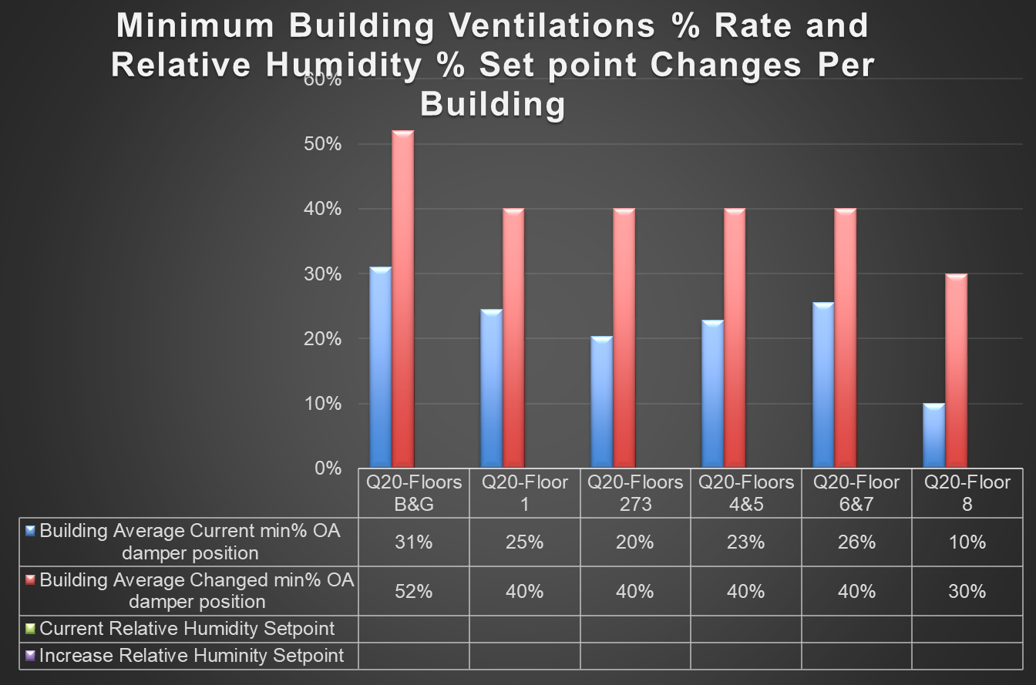
Summary of Buildings HVAC Recommendations and Implementation

Slide 10
Summary of Recommendations and Implementation
Initiative started- April 2020
Completed- November 2020
Total cost:$66,647
  BP- 328 man hour/$16,109 labor cost/$938 material
  FE- 118 man hour/$12,000 labor
  Filter cost due to COVID-19- $22,000
  Purchased room air purifier- $10,000
  Rent room air purifier- $5,600

Slide 11
Data/Lessons Learned
BP developed a plan for re-checking and tuning dampers.
Preliminary checks on some AHUs indicates they have a little higher %OA than our target number.
Due to season change BP- spot checking actual %OA using the temperature method and confirming that method with airflow measurements at a few AHUs.
Keep recorded data to help modify future changes
Incorporate AHUs flexibility in new projects/building design.

Slide 12
Next Step
Started- Denver campus on Dec 3rd.
LSC – report ready by Dec 21st.
AB1 – by Jan 8th
School of Business – by Jan 15th
CU – by Jan 29th
Student Wellness – by Feb 12th
Lynx Crossing – by Feb 27th

