Slide 1
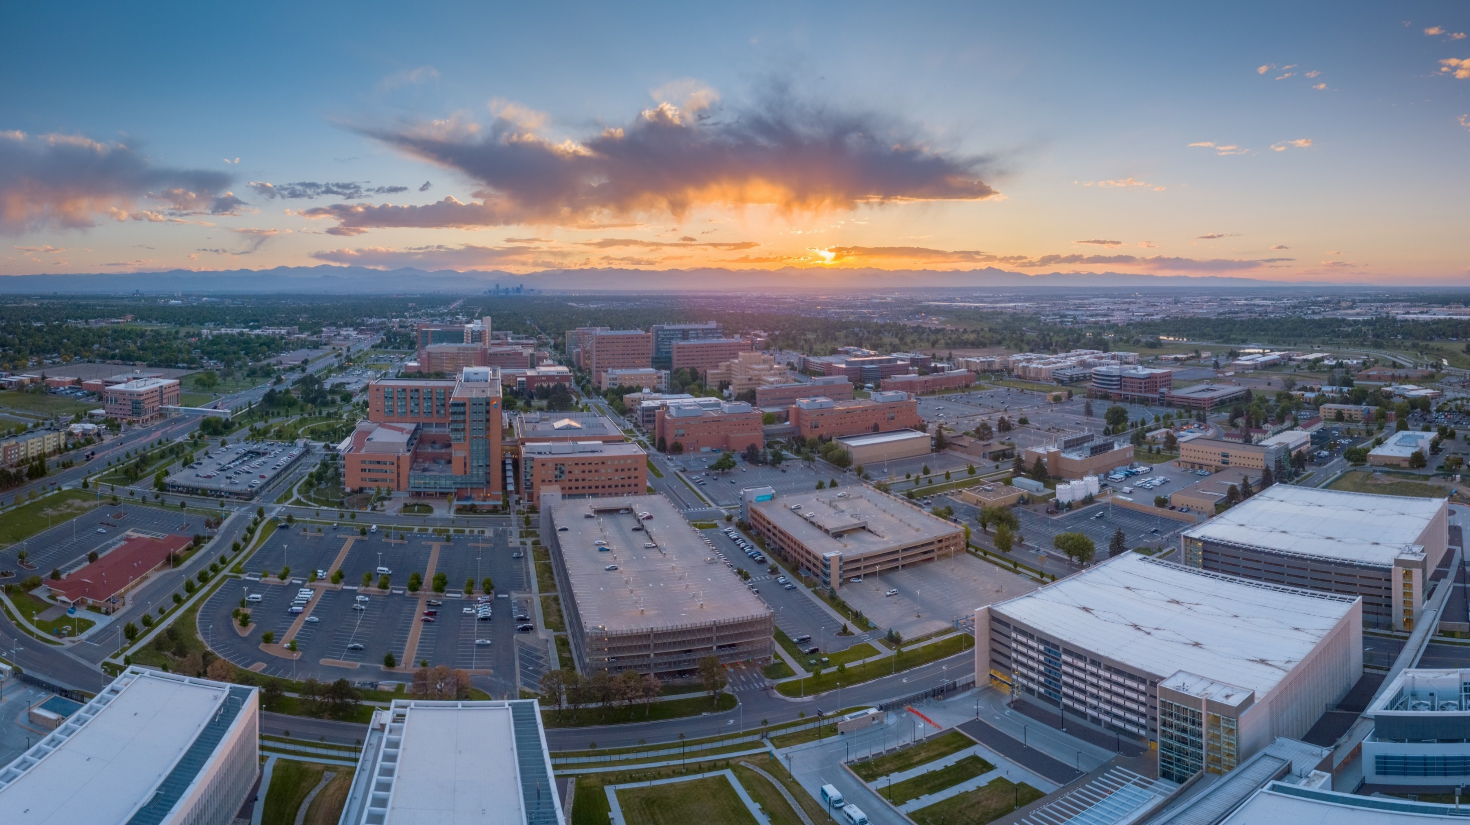
We will start at 12:10pm
Meeting Agenda
Introductions – Poll Everywhere
Guest Speaker
Carl Johnson, Director of Student Engagement
Event Planning
Student Organization Announcements
Presidents Round Table
February 2023
Office of Student Engagement

Slide 2
PRT Meeting Agenda
Introductions – Poll Everywhere
Guest Speaker
Carl Johnson, Director of Student Engagement
Event Planning Process
Event Spaces/Facilities
Risk Management
Equipment
Minors
Contracts
Student Organization Announcements

Slide 3
Guest Speaker
Carl Johnson Director of Student Engagement Carl.Johnson@CUAnschutz.edu

Slide 4
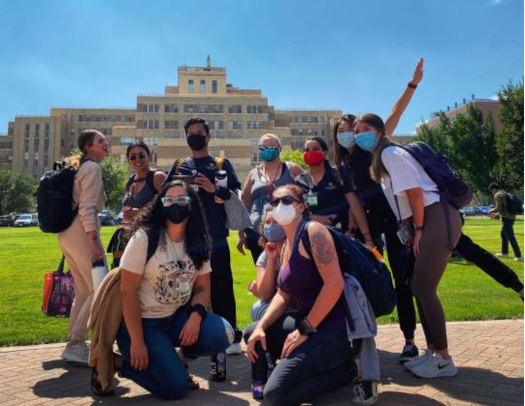
Types of Student Organizations
Campus Wide
Affiliated
Associated

Slide 5
Event Planning
Planning Process
Event Spaces/Facilities
Risk Management
Equipment
Minors
Contracts

Slide 6
Event Planning Process
To Start -
Campus Wide and Associated fill out the Event Support Request form
Affiliated organizations reach out to their responsible office
Request a room reservation on EMS Reservation system.
Your advisor must be involved in this process
Event Spaces/Facilities, Risk Management, Equipment, Minors, Contracts, etc.

Slide 7
Risk Management
Please reach out to your Responsible Office
Events with Alcohol (3 months in advance)
Insurance Certificates of Insurance | University of Colorado (cu.edu)
Film, Photo, and video approval (Drones)
Minors*
Waivers and Consent
Website: Event and Activity Planning | University of Colorado (cu.edu)
Campus Wide and Associated – Katelyn Martin
Affiliated – Department Staff

Slide 8
Equipment
Fill out the equipment request form located via our website, 2 weeks in advance.
Sign out/in equipment
Cornhole/Bags, Volleyball, Spikeball, Badminton, Soccer ball, Frisbee, Large and small footballs (ping pong in library)
Hot Drink Dispenser (100 cups)
Popcorn Machine
Speaker with mic
Outdoor movie set up
Website: Student Org Event Planning (cuanschutz.edu)

Slide 9
Minors
Reach out to Responsible Office (4-6 months in advance)
Complete criminal and National Sex Offender Registry background check hr.backgrounds@ucdenver.edu ($40 per person)
Complete training with Student Engagement Coordinator
Student planner and Advisor must be present
Fill out Child protection Policy form
Complete minor training with all university faculty, staff, student, and volunteer who will be working with minors
Volunteer, Trainee and Minor Participants | University of Colorado (cu.edu)

Slide 10
Contracts
Contracts are legal and binding agreements.
A contract can be verbal or written, and they can be called different things, such as agreements, memorandums of understanding, terms and conditions, etc.
All contracts must be submitted to your Responsible Party for review and approval (University Department)
No student or advisor may sign a contract that binds the university. Anyone who signs a contract or enters into an agreement becomes legally liable for that agreement, including payment.
All contracts must be submitted thirty (30) days in advance of the required date. The more detailed the contract, the longer the process could take.

Slide 11
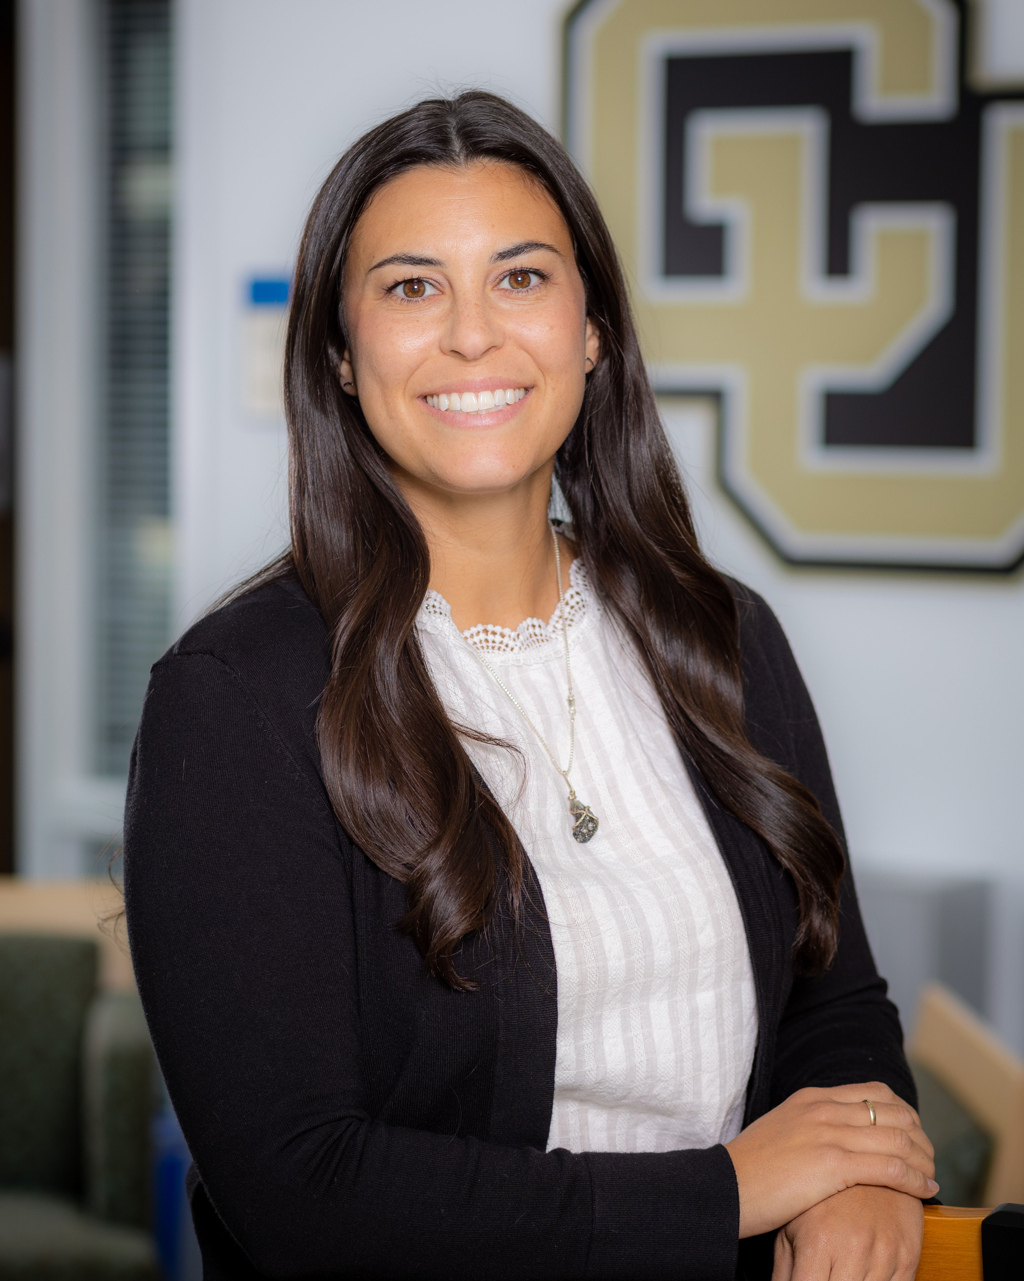
Contact Us
Student Affairs
Office of Student Engagement
Education 2 North, Suite 3200
studentaffairs@cuanschutz.edu – (o) 303.724.4435
Katelyn Martin
Coordinator of Student Engagement – Education 2 North, 3201
Katelyn.martin@cuanschutz.edu – 303.724.4435

