Slide 1

Retired Faculty Association Celebration Luncheon
May 29, 2026
Maureen Leehey, MD
Professor Emerita of Neurology
Transitional Retired Faculty Representative, Faculty Assembly
Jodi Waterhouse, MHA
Director, Strategic Partnerships & Programs
CU Anschutz Multidisciplinary Center on Aging

Slide 2


Agenda
Welcome
Dr. Richard Krugman, “Highlights of Efforts to Find More Room For Our Work”
Lunch
Presentation of Officers
Table Discussions & Summary Presentations
Concluding remarks

Slide 3
Tables – Please Visit Them All!
Membership
Committee sign-up –
Multidisciplinary Center on Aging (MCoA)
Alumni

Slide 4
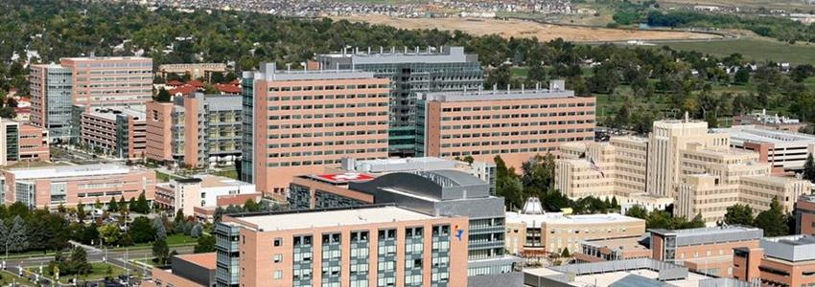
History of the RFA
Since 2007, lunches 3-4 x annually
Correspondence via Mail
Supported by Academic & Student Affairs, SOM Faculty Affairs
  Dr. Roderic Nairn, Executive Vice-Chancellor, Academic & Student Affairs, $4,000 annually
  Dues
Run by John Freed (Graduate School) & Lee Potter (CU Denver)
No activity since COVID

Slide 5
RFA Progress in Past Year
Mission
  The Association exists to foster the interests and well-being of retired faculty members of the University of Colorado Anschutz Medical Campus, support social and educational opportunities, maintain active ties with the university, encourage volunteerism, mentorship/supporting junior faculty and advocate for issues of concern to retired faculty, and faculty looking to retire.
Accomplishments in past year
  Wrote and approved draft bylaws
  Created website
  Established support
    Renewed ties to CU: Provost, Alumni/Advancement
    Formed major liaisons: MCoA w/ SOM support
  Elected Officers

Slide 6
Highlights of the Efforts to Find More Room for Our Work
Richard D. Krugman, MD
Distinguished Professor of Pediatrics
Dean, University of Colorado School of Medicine (1990-2015)
VC for Health Affairs, CU Anschutz Medical Campus (2007-2015)

Slide 7
Thank You
&
Presentation of Officers
Notes:
BEST PRACTICES & ACCESSBILITY STANDARDS:
To add a new slide, go to Insert in the navigation bar > New Slide and click the drop-down arrow to choose from different slide layouts and designs.
For body text keep font size at 18pts or larger. For headers keep font size at 24pts or larger.
For any new image or icon you add please add a description in the alt text. Right click image > click on View Alt Text > type in image description

Slide 8
Launching Committees & Members
Thank you!
Bylaws Committee: Roger Giller, Barbara Helfrich, Leslie Jameson, Christopher Korch, Maureen Leehey, Arlen Meyers, Elaine Spector-Christensen, Bob Schwartz, Jodi Waterhouse
Executive Planning & Nominating Committee: Roger Giller, Mike Glode, Madeleine Kane, Christopher Korch, Maureen Leehey, Arlen Meyers, Bob Schwartz, Jodi Waterhouse
Website Committee: Leslie Jameson, Maureen Leehey, Arlen Meyers, Jodi Waterhouse, Elias Born
Events Committee: Barbara Helfrich, Maureen Leehey, Elaine Spector-Christensen, Jodi Waterhouse

Slide 9
Jodi Waterhouse, MHA
Director of Strategic Partnerships & Programs
CU Anschutz Multidisciplinary Center on Aging
Notes:
BEST PRACTICES & ACCESSBILITY STANDARDS:
To add a new slide, go to Insert in the navigation bar > New Slide and click the drop-down arrow to choose from different slide layouts and designs.
For body text keep font size at 18pts or larger. For headers keep font size at 24pts or larger.
For any new image or icon you add please add a description in the alt text. Right click image > click on View Alt Text > type in image description

Slide 10
RFA Governance
Executive Council
  Officers (5)
  Members-At-Large (5)
  Standing Committee Chairs (~5)
  Associate Members (non-voting, appointed by Chair)
Advisory Committee
  Relevant CU reps (Provost office, HR, etc.)
  Makes recommendations twice yearly

Slide 11
Nominations and Elections
Voting occurred via secure, anonymous electronic ballot
Nominations: March 18 – April 17, 2026
Elections: April 23 – May 23, 2026
Results
  62 voters (verified)
  Schools
    44 Medicine
    9 Nursing
    5 Public Health
    2 Dental Medicine
    2 Pharmacy

Slide 12
Congratulations to newly elected officers!
Chair: Barbara Helfich, MSc (1 year term)
Chair-Elect: Robert Schwartz, MD (1 year term )
Secretary: Cordelia Rosenberg, PhD, RN (2 year term)
Treasurer: Elaine Spector-Christensen, PhD (2 year term)

Slide 13




Thank you! Questions?

